Slide 1





CONSEQUENCES OF
ORAL HEALTH
NEGLECT IN ELDERLY
Yolanda Mangrum, DDS, MAGD, LLSR

Slide 2
More elderly are keeping their teeth, unfortunately 87% of residents living in skilled nursing facilities do not receive even basic oral care such as brushing.

Slide 3
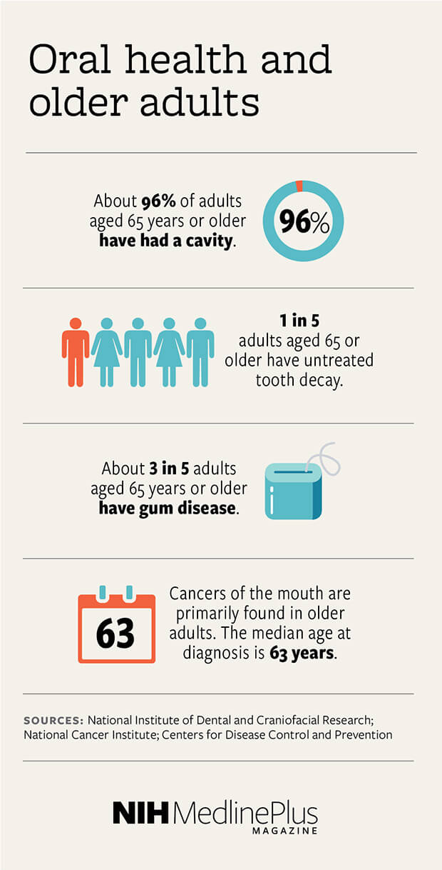

Slide 4
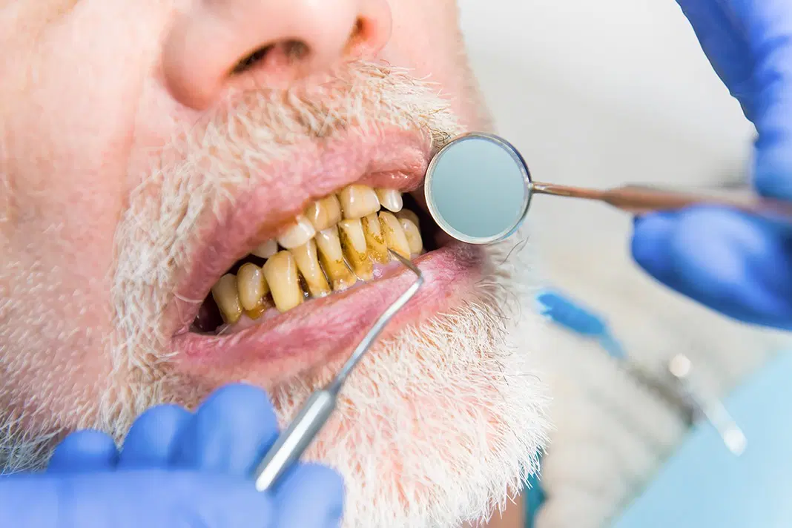

Slide 5
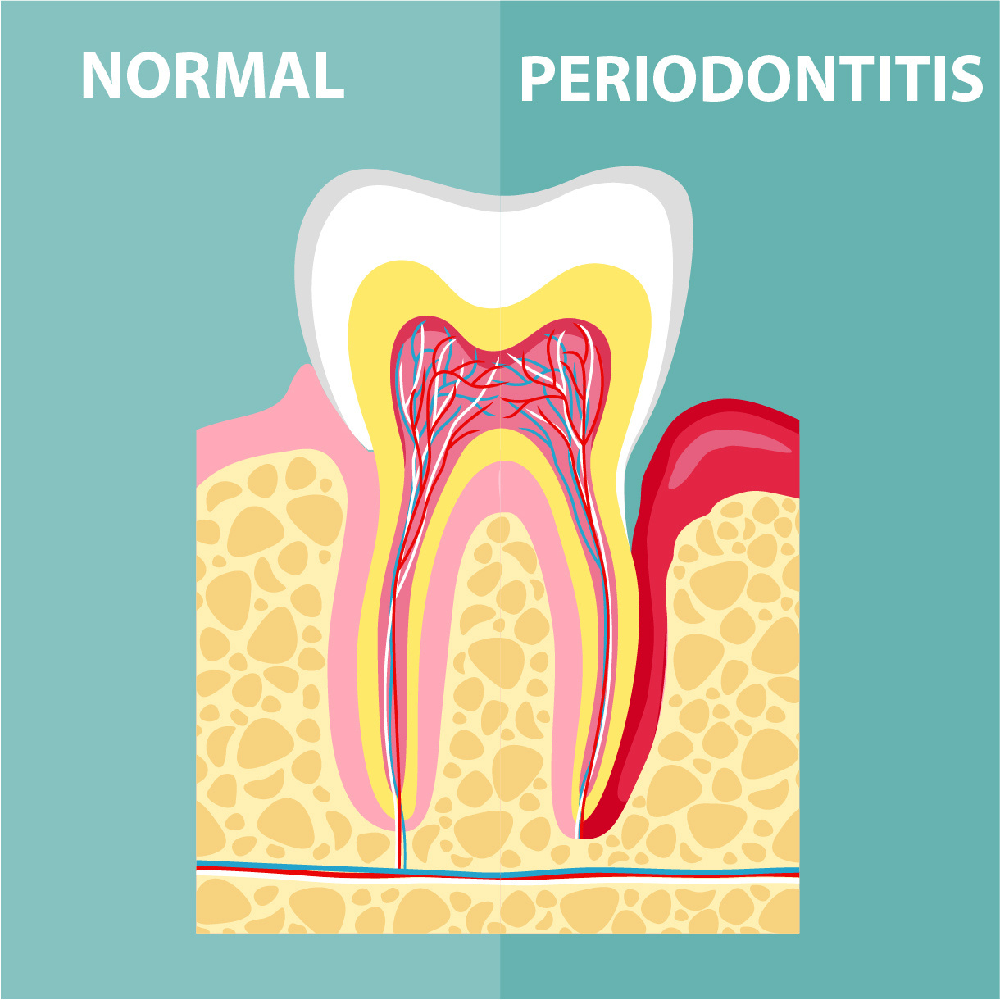

Slide 6
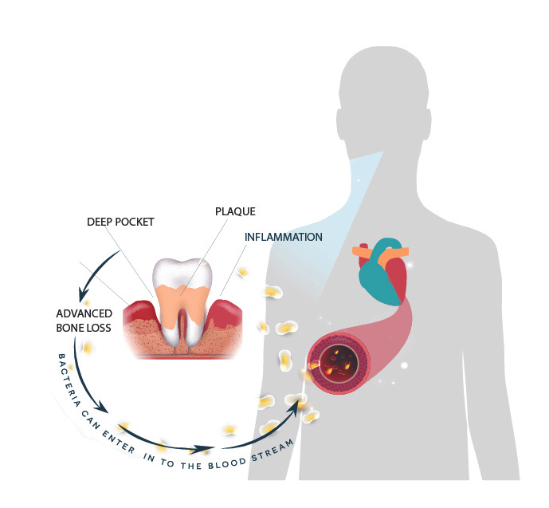
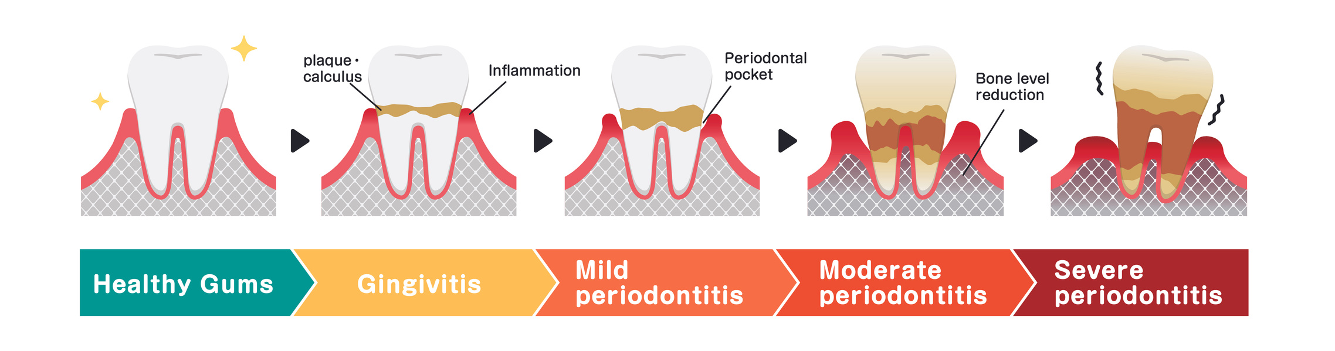

Slide 7
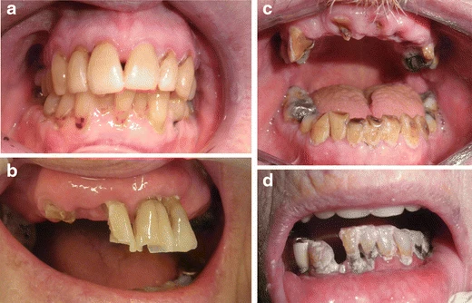

Slide 8
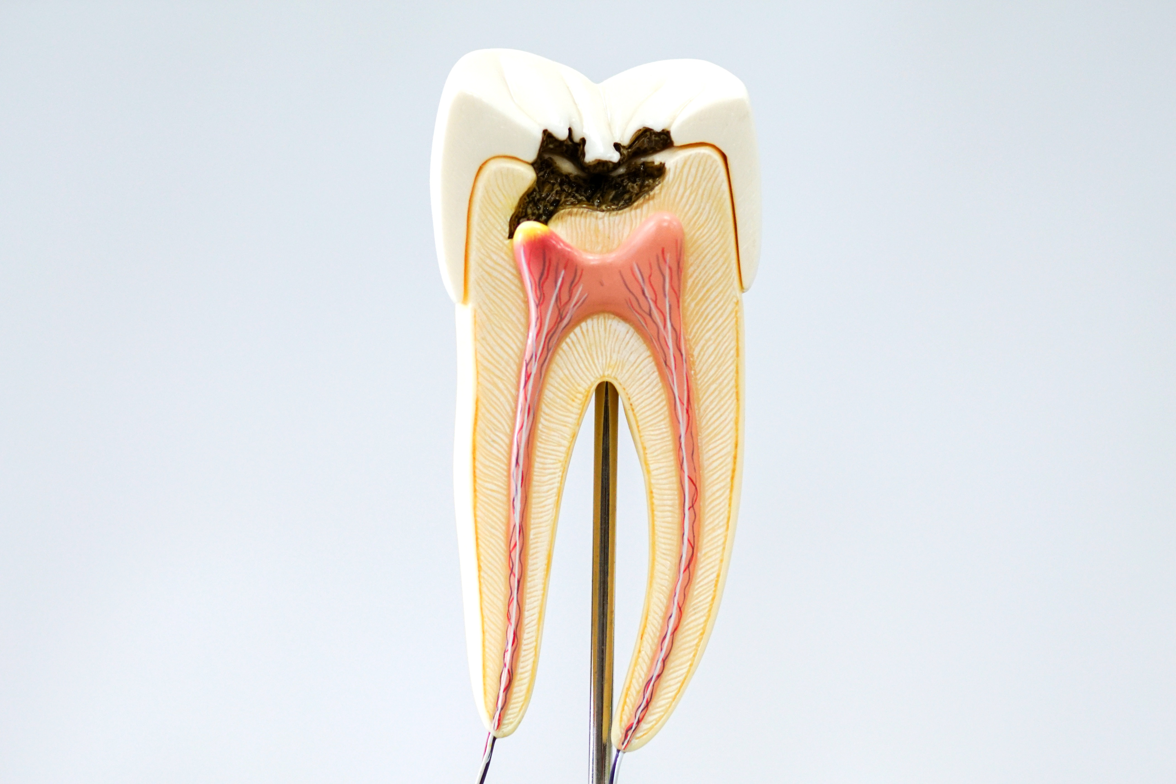
Tooth Decay

Slide 9
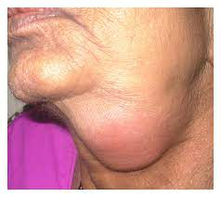
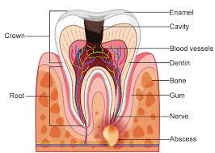
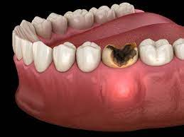
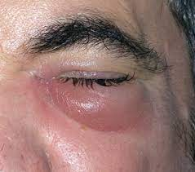
DENTAL ABCESS &
FACIAL SWELLING

Slide 10
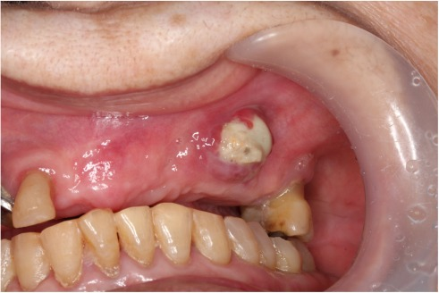
Brain Abscess of a Very Elderly Patient Likely Caused by Maxillary Osteomyelitis from Odontogenic Infection

Slide 11
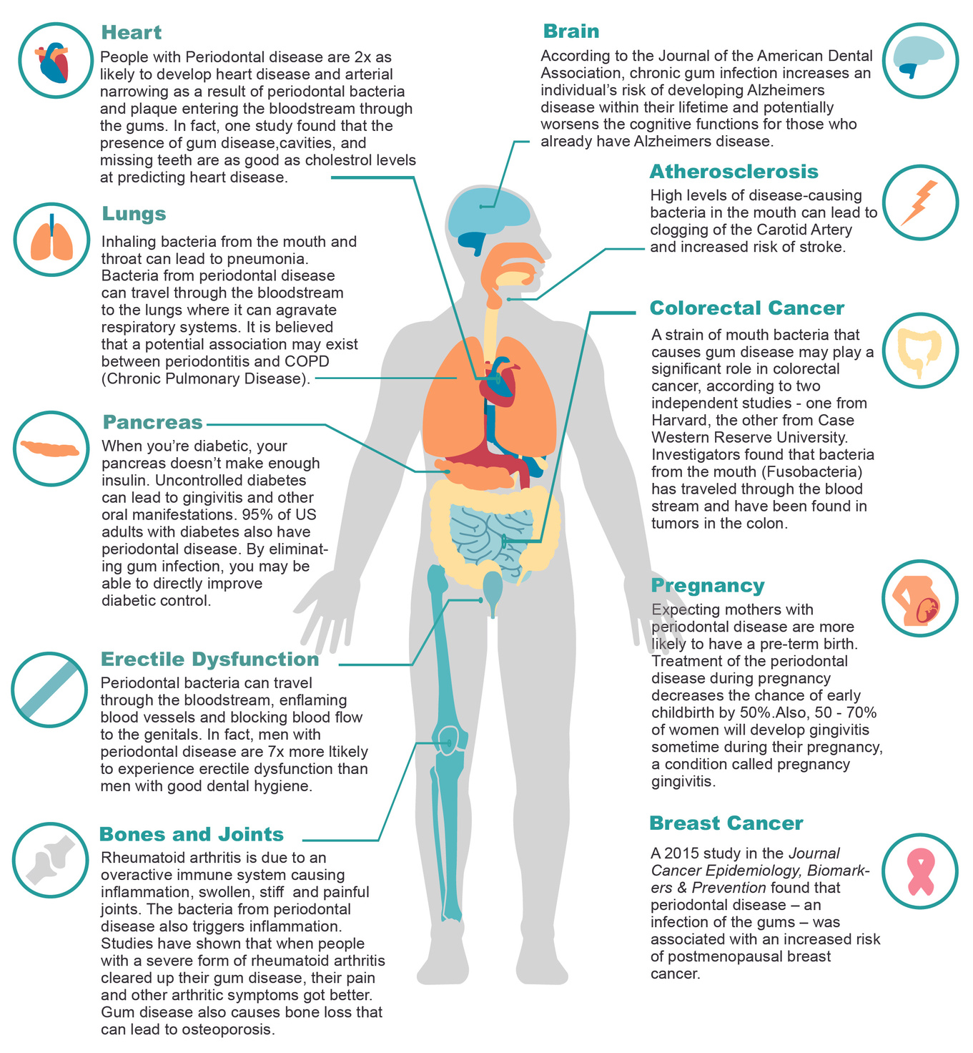

Slide 12
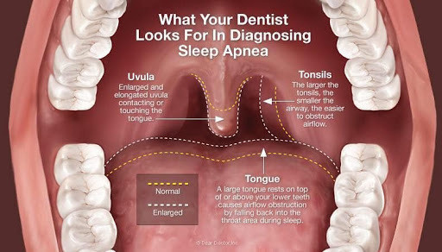

Slide 13
SYSTEMIC BACTEREMIA
Pneumonia is the most common cause of infectious death among nursing facility residents. Uncontrolled oral bacteria can lead to pneumonia, diabetes, strokes, and heart attacks; it has even been linked to Alzheimer’s disease.

Slide 14
POOR ORAL HEALTH
Elders with Alzheimer’s typically have poor oral care and a higher incidence of oral diseases.

Slide 15
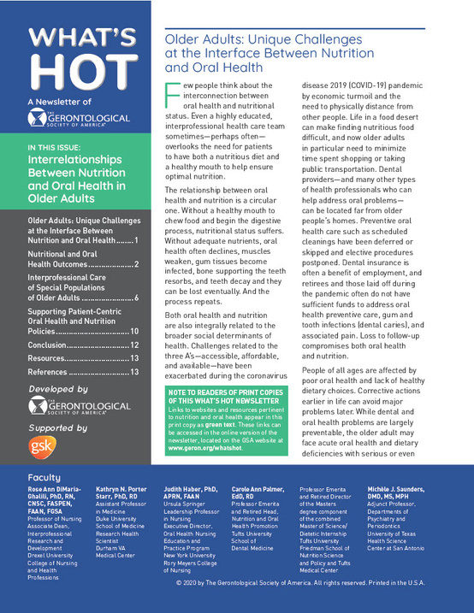
POOR NUTRITION EFFECTS
  Increased Malnutrition-(negatively impact your physical and mental health)
  Delays from recovering from illness
chrome-extension://efaidnbmnnnibpcajpcglclefindmkaj/https://health.mo.gov/living/families/oralhealth/pdf/whats-hot-nutritiono-oral-health-older-adults.pdf

Slide 16
ELDERY ORAL HEALTH ISSUES
  Multiple Medications Leads to Dry Mouth Leads to Tooth Decay
  Oral Cancer
  Recessing Gums
  Gum Disease Leads to Tooth Loss
  Older adults are frail and heal slowly, making it difficult to accurately assess suspected injuries caused by abuse.

Slide 17
ELDER ABUSE DEFINITION
“actions or lack of actions that harm an older adult or put him or her at risk of harm, which may be physical, emotional, and/or financial.”
“mistreatment that is committed by someone with whom the elder has a special relationship (spouse, sibling, child, friend, or caregiver).”
https://dimensionsofdentalhygiene.com/article/addressing-elder-abuse/

Slide 18
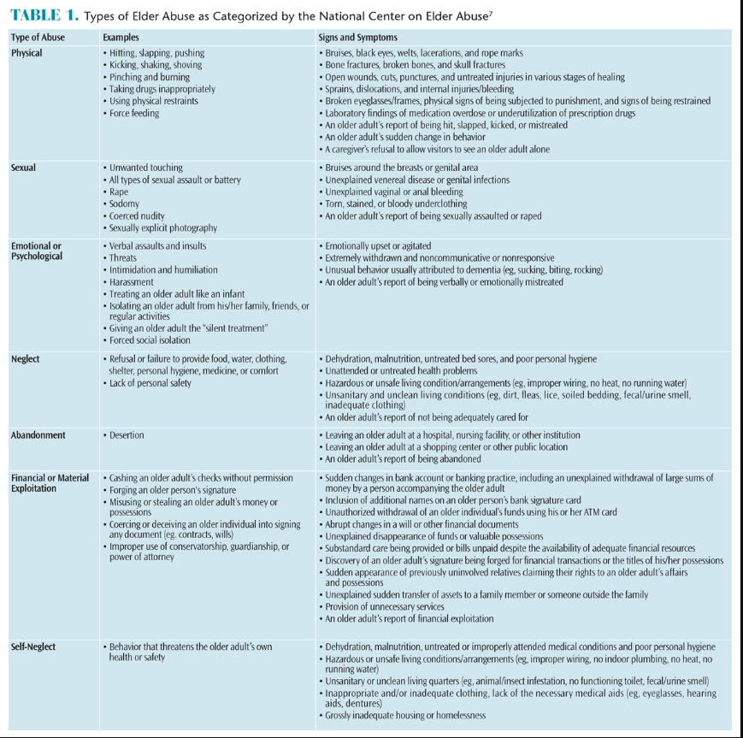
TYPES OF ELDER ABUSE
physical,
sexual
emotional/psychological,
neglect,
abandonment,
financial or material exploitation,
self-neglect
https://dimensionsofdentalhygiene.com/article/addressing-elder-abuse/

Slide 19
NEGLECT ORAL HEALTH ABUSE
intentional or unintentional refusal or failure to provide any part of one’s duties in caring for another which may result in harm
  Withholding food/water, clothing, shelter, attention
  Failure to assist with activities of daily living (ADL), provide glasses, dentures, walker/cane, hearing aids
  Failure to ensure personal safety, health, finances
  Denying medications, medical or dental treatment

Slide 20
ORAL HEALTH NEGLECT
  Delay between onset of illness and seeking medical/dental treatment, untreated medical conditions
  Noncompliance with medication, appointments, or instructions
  Dehydration or malnutrition, sunken eyes, unexplained weight loss
  Poor personal or oral hygiene
  Rampant decay or untreated periodontitis
  Ill-fitting dentures or lack of dentures
  Epulis fissuratum, candidiasis

Slide 21
SIGNS OF ORAL HEALTH NEGLECT
  Caregiver and patient provide different explanations of injuries/oral conditions
  Caregiver doesn’t allow the patient to answer questions or seems hostile toward the patient
  Caregiver appears inattentive or has a lack of knowledge of the patient’s needs
  Caregiver appears overwhelmed, angry, or frustrated with the older adult
  Evidence or suspicion that the caregiver is abusing alcohol or drugs is also a red flag for elder mistreatment.

Slide 22
YOLANDA MANGRUM, DDS
(707)762-0067
INFO@PETALUMADENTAL.COM
(707)787-7095
INFO@ALLUMEMEDSPA.COM
WWW.LUMINARYEDUCATION.COM

