Slide 1
Hooked!
When the Best in Us
Creates the Worst for Us
Notes:
We all consider ourselves to be good people, wanting to help others, to do well by our loved ones or even wanting to change a stranger’s life for the better. This self-perception is a virtue but may be a hook for anyone, particularly older adults who may be lonely, isolated or experiencing loss. By fishing for an opening in personal narrative, scammers bait their victims into their net of deception. Professionals who interact with people who are being scammed may be able to reach the individual by better understanding the altruistic desire behind the bad decisions they are making in the moment. This training will focus on the emotional context of a scam victim while discussing the spectrum of how tightly held the belief in the scam is for that victim. We will discuss ways to connect with the victim in hopes of preventing further financial loss.

Slide 2


Overview
Goal: Fraud Prevention
Statistics
The challenge at hand: manipulation
Types of scam and how we get hooked
Undue influence vs personal narrative
The psychology of personal narrative
Dopamine
Tools and techniques

Slide 3
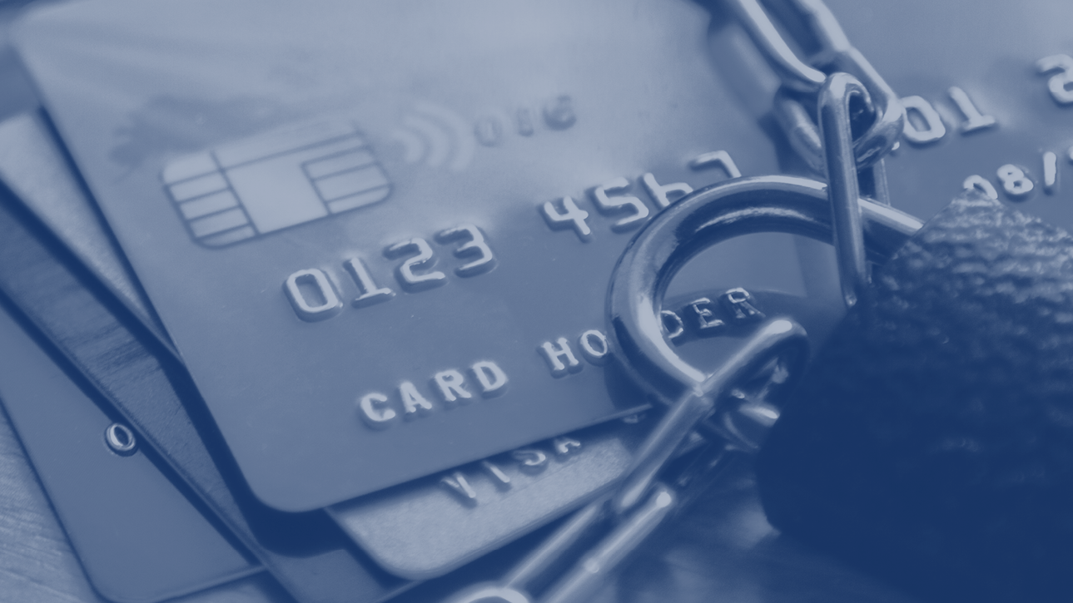

Goal: Fraud prevention
From the professional’s perspective…is it:
  A Gun to the head or
  Autonomy of a personal decision
Notes:
Its much easier to intervene when a person is obviously being coerced or threatened
When the victim is a willing participant it gets more complicated
So why are people willing to go along with it?

Slide 4
An elder walked into a bank… or an Attorney’s office or a medical office…
Person may or may not have decision making capacity
No gun to the head
Acting on their own autonomy
But…
Manipulated into acting against their best interest
How can we identify the risks and intervene when the elder has capacity?
Notes:
Person may or may not have decision making capacity
No gun to the head
Acting on their own autonomy
But…
Manipulated into acting against their best interest
In between are the powerful feeling invested in personal narrative
What seems like individual autonomy may be coming from a very compelling manipulated, false narrative

Slide 5

Notes:
FBI
You know better than I do what an epidemic of theft is occurring at the confluence of an aging population, social media explosion and pandemic isolation

Slide 6
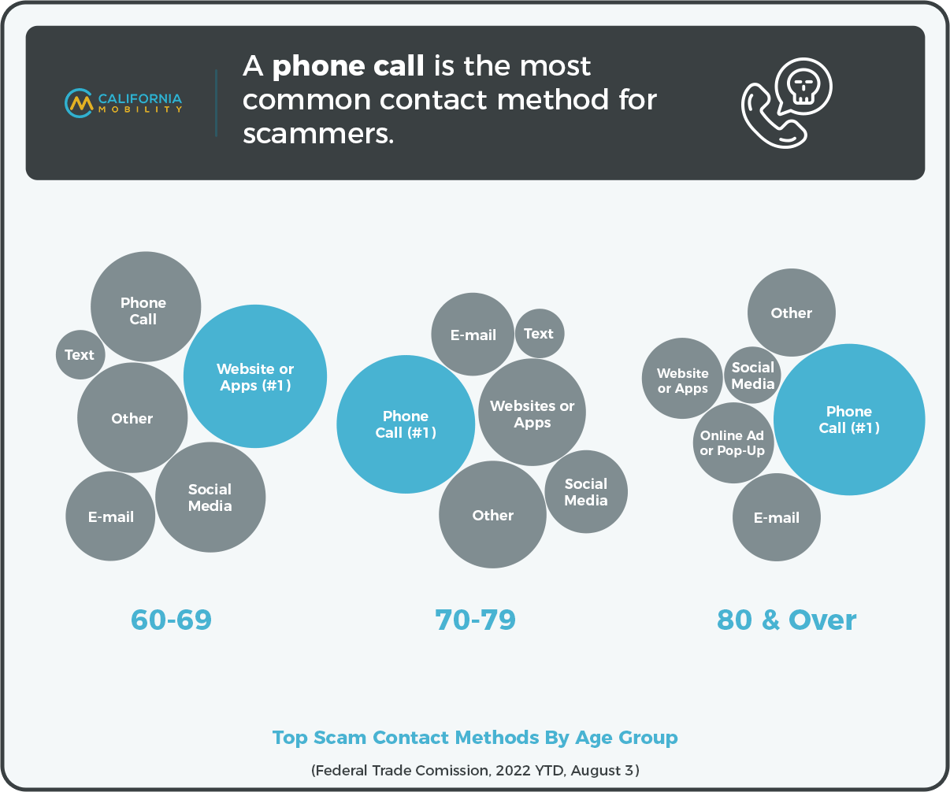
Notes:
Elders targeted by phone contact

Slide 7
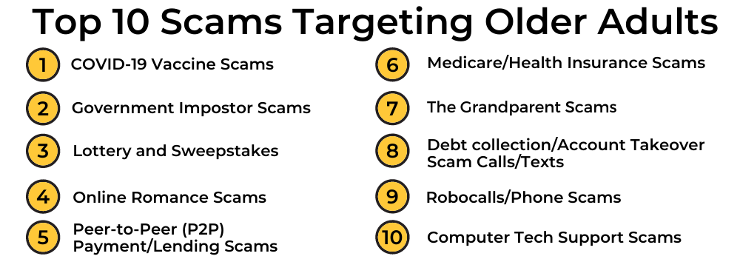
Notes:
https://aging.maryland.gov/Pages/ScamsFraud.aspx

Slide 8
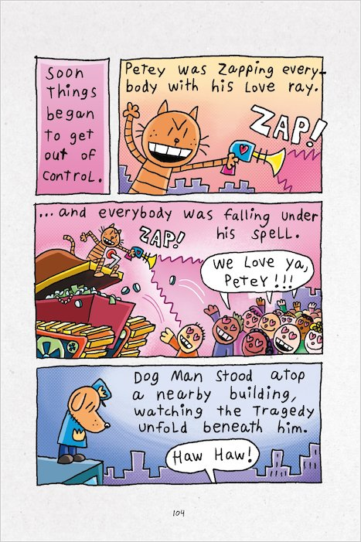
Notes:
Dog man unleashed

Slide 9
Undue influence vs. Personal Narrative
What is undue influence?
Dependency
  Sensory or functional deficits
Authority/Caregiving
Grief/recent loss/death of a spouse
Threat of abandonment
Quid pro quo
If you don’t do what I say, then I’ll leave you and you’ll die
Notes:
Undue influence refers to a per- son’s free will being usurped by the will of another.
Predisposing factors
Loss, death of a spouse
Depression
Isolation
Anxiousness
Dependency
Diminished capacity
Vulnerability enhancers:
Relationship positioning
Self promotion
Execution variables:
Increasing the persons vulnerability
Pressuring
Puppeteering

Slide 10

My Story: Personal Narrative
Hooked by my story of:
Altruism
Connection
Status
Legacy
Helping/saving
Fear
Notes:
The compelling personal narrative is manipulated by the scammers
Hooked by my story of:
Altruism-
helping a relative or friend or helping the scammer
Connection-
feeling loved or befriended and cared. for
Status-
winning the lottery, becoming wealthy or being a valued member of the community
Legacy-
passing on resources or a story of success or prowess
Helping/saving-
the special position of being the only one who can save the poor victim
Fear- the wish to alleviate suffering and find security
From the individuals perspective they are just trying to do what they think is right

Slide 11


McAdams: Narrative Identity
Empowered Protagonists
Passive Targets
Communion = Connection with others
Redemption = positive meaning in negative events
Simple, Coherent = Easy to Follow
Scammers use these as bait
Notes:
What does this research say?
Dan P. McAdams (born February 7, 1954) is personality psychologist and the Henry Wade Rogers Professor in the Department of Psychology at Northwestern University.^{[2][3]}
There’s pretty clear research actually, which has four points to make.
1.) The first is that life stories that feature protagonists or main characters who feel empowered agency tend to be associated with psychological wellbeing.
For example, “I’m the only one who can help my friend to pay their taxes and save their estate. I can do this and no one else can!”
When people feel beaten down, when the main character of the story is passive and has no control, those kinds of stories tend to be associated with negative outcomes.
“I’ve retired and am on a fixed income and cant really afford to help. There’s nothing I can do!”
2.) Communion is also good. It means having a story in which the main character is connected richly to many other people and finds meaningful interactions, relationships, love, friendship and so forth.
(Sweet-heart scams)
3.) The third one is redemption, which refers to stories in which suffering is overcome. Stories in which people find positive meanings in negative events.
“My dear friend was put in jail for tax evasion and it’s extremely unjust but if I pay all the fines and penalties he will be let out and we can live together.”
4.) And finally, stories that are more coherent and easier to follow, tend to be associated with psychological wellbeing. So, it's good to tell life stories in which the protagonist is agentic, is engaged in warm close relationships, is resilient and forms a coherent narrative. Still, you can't just make those up. Lived experience needs to resonate with the story.
Simple, good guys and bad guys. And the scammer and the victim are the good guys
https://northbynorthwestern.com/the-stories-we-tell-about-ourselves/

Slide 12

Scammers leverage cognitive biases.
These are mental shortcuts that we all use
Optimism bias: the belief that we’re less likely than our peers to experience negative events and more likely to experience positive ones.
Exploit how we process information
There are two ways we process information:
The central route, where there is deeper, more logical processing
The peripheral route, which is more superficial, emotion-based processing
Scammers use techniques, such as creating urgency, to activate this peripheral route so that victims make quicker and poorer decisions.
Notes:
Dear Victim”. Understanding the psychology behind scams
Ms. Carolyn Misir, principal psychologist at the Police Psychological Services Department, explained, “Scammers leverage cognitive biases. These are mental shortcuts that we all use.”
Optimism bias: which is, simply put, the belief that we’re less likely than our peers to experience negative events and more likely to experience positive ones.
Exploit how we process information
There are two ways we process information:
The central route, where there is deeper, more logical processing
The peripheral route, which is more superficial, emotion-based processing
Scammers use techniques, such as creating urgency, to activate this peripheral route so that victims make quicker and poorer decisions.

Slide 13
Connecting the dots
Scams
Personal narrative
  Lottery
  Sweetheart
  Savior
  Threat
  Problem solving (computer tech reaching out to help with a fix)
Altruism
Connection
Status
Legacy
Fear
Notes:
Examples:
Ms. jones is certain she won the lottery and just needs to pay the taxes, then she will be able to buy her granddaughter a house (Altruism/legacy)
Mr. smith is in love with a woman who called him “by accident” and they had an instant soul connection (Connection)
Ms. Kay has been connecting with frank for three years and has to keep sending money to a third party otherwise frank will be killed by the people who have kidnapped him Fear/altruism)

Slide 14

Scammers use the following tricks
Scammers often use psychological triggers to get an automatic response from you without you realizing it.
Reciprocation
Social proof
Liking
Authority
Scarcity
Personalized scams
Incremental commitment
Notes:
Scammers often use psychological triggers to get an automatic response from you without you realizing it. Watch out for them next time you're approached, or even next time someone asks you for a favor. Some of the tricks they use are outlined below. When we're up against these influence strategies, getting caught up in a scam is not necessarily a reflection of our gullibility or poor judgement. It just shows how good the scammers are at manipulating us. Don't be clouded by influence triggers. Recognize them for what they are, and keep a clear head when making decisions.
Scammers use the following tricks
Reciprocation
Scammers give you something, such as a 'free' gift or assistance, to get something in return, such as your agreement later on. You are caught up feeling obliged to do something. Protect yourself from those sentiments by recognizing the gifts and favors as nothing more than devices to influence you to return the favor.
Commitment and consistency
Someone will get you to commit to something early in the piece, and later recall that initial agreement to get you to agree to something further. This ploy can make you feel ill at ease. To protect yourself, you should treat each commitment separately and ask yourself whether, under the circumstances, you would make the same choice as you did earlier. Your instinctive gut-feeling will provide the answer.
Social proof
‘Everybody does it, so it must be right’ pretty well sums it up. The other person will refer to what the majority does to get you to agree. Objectively check the facts, your experience and judgement.
Liking
Good looks, similar interests or background, humor and other attractive characteristics are standard tools for the con-artist as well as of course for honest people who want to generate good rapport with you. If you like someone, you're more likely to go along with what they are suggesting. Your defense is to separate the issue on offer from the person offering it or associated with it.
Authority
Authority, in or out of uniform, will cause an automatic response in almost everyone. We appeal to and use authority all the time to justify or support our position. Scammers do it deliberately to hoodwink you into agreement. Your protection here is to ask whether the authority is relevant to the context.
Scarcity
FOMO The fear of missing out! Being told that this is the last chance or that there are only so few still available, leads most people to agree hastily before they have had the opportunity to think about what they're doing. Some people have found themselves in horrible financial situations because they rushed into agreements or purchases in the fear of missing out. Your protection here is to separate your emotions from your decisions
Personalized scams
Personalized scams occur when a scammer gathers your personal information and uses it to specifically target you with a scam. The fact that the scammer knows so much about you may lead you to believe they are legitimate. View this video to see ACCC Deputy Chair Peter Kell discuss some specific examples of personalized scams and how you can avoid them.
“In our society it is difficult to say no once you have said yes. So, once they get you to do one action it is easier for you to do another, even multiple times. As soon as you have committed yourself to a course of action, it is difficult to walk away! It becomes an automatic practice — as if you were following a script.
“We want to be seen as a team player. We want to follow the rules. Add to that intimidation and bullying. Debra was threatened. How many vacuum cleaners have been sold to people who fell victim to a high-pressure sales pitch and could not tell the salesperson to leave their home?”
https://www.scamnet.wa.gov.au/scamnet/Scam_prevention-The_Psychology_of_Scams.htm

Slide 15

Persuasion
Assistant Professor of Psychology Kenneth Tan from the Singapore Management University outlines several persuasive techniques scammers employ:
Truth Bias
Authority
Increased Heuristic Thinking
Foot in the Door
Sunk Cost
Similarity
Notes:
Assistant Professor of Psychology Kenneth Tan from the Singapore Management University outlines several persuasive techniques scammers employ:
Truth bias: Exploiting the human tendency or assumption that others are telling the truth, especially when it’s repeated consistently. They could prey on loneliness and fulfil one’s need to belong by getting you to trust them.
Authority: Intimidate by claiming to be from official government sources (such as the Ministry of Health, Police). They could also establish credibility through the use of authority, which also results in greater trust.
Increased Heuristic Thinking: Using large sums of money, promise of cures etc. Higher heuristic processing might lead to lower rational processing. They could also use scarcity, or time pressure to get people to respond immediately. This also reduces rational processing or the ability to verify information provided by scammers.
Foot in the door: By getting you to commit to small commitments first, people want to remain consistent and are hard pressed to say no later after saying yes earlier. Scammers build momentum in this way.
Sunk costs: After victims transmit a small sum of money, scammers explain that more money might be needed to complete the transaction. Victims comply because they do not want to lose the time, effort or money that they had initially invested, even if it might not be the most rational thing to do.
Similarity: Scammers try to make victims believe they have something in common with them, to induce trust and reciprocity.
Said Ms. Misir, “What we do notice across different scams is that not just one technique is used. It's always a combination of various kinds of techniques, depending on the kind of scams.”

Slide 16

red flags to look out for
Said Ms. Misir, “What we do notice across different scams is that not just one technique is used. It's always a combination of various kinds of techniques, depending on the kind of scams.”
You are pressured a lot, without time to respond
You are asked for small fees for bigger returns
Scammers will not meet you face to face
Scammers may want to get payment in a strange way
Notes:
Said Ms. Misir, (principal psychologist at the Police Psychological Services Department )
“What we do notice across different scams is that not just one technique is used. It's always a combination of various kinds of techniques, depending on the kind of scams.”
Assistant Professor of Psychology Kenneth Tan, Singapore Management University shares some red flags to look out for.
You are pressured a lot, without time to respond
You are asked for small fees for bigger returns
Scammers will not meet you face to face
Scammers may want to get payment in a strange way
Take a “cognitive break”

Slide 17
Case Examples
Scenario 1: A resident of a Sonoma assisted living facility spent her mornings on the phone with a particular scammer that would call her every day at 9:30am. After months of talking together, he finally shared a personal tragedy with this resident that required a large amount of cash to get out of - and this resident wanted to help. Realizing this would sound suspicious, she went from branch to branch withdrawing $9,000 at each location giving the teller and branch manager a plausible ‘family-emergency’ excuse, denying any fraud. After each branch visit she placed the case in a UPS box in her car and drove to the next branch. After the 4th branch, one manager followed her to her car and noticed the box with more than one transaction. At that point, the manager insisted she stop, sit and reconsider. It was only at this moment, after ‘being found out’ that the customer was able to admit and recant.
Notes:
Called her every day
Built a relationship (reciprocation and liking)
Convinced her she was the only one who could help (Personalized scam)
Got her to commit and continue to give (commitment and consistency)
Was charismatic and attractive (Liking)
Convinced her she would benefit both emotionally and financially and this was the last chance (scarcity)
Was ashamed to acknowledge what she was doing (incremental commitment)

Slide 18

Powerlessness & Power
One of the reasons people get hooked is the felt sense of powerlessness in aging
The promise of the scammer instills a sense of power, efficacy and importance
It’s all about meaning.
Notes:
One of the reasons people get hooked is the felt sense of powerlessness in aging
loss of status, loss of role, loss of resources: retirement, fixed income, distancing from loved ones, loss of a partner = felt sense of powerlessness
The promise of the scammer instills a sense of power, efficacy and importance
It’s all about meaning.

Slide 19
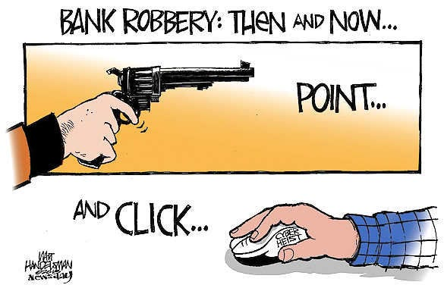
Not a gun to the head
Scammer positioned as ally
  Splitting, joining
Examples:
Helsinki syndrome
Brainwashing
Hooked by the narrative
Notes:
Scammer positioned as ally
Splitting, joining
Examples:
Helsinki syndrome
Brainwashing

Slide 20

False Narrative
A competent person may willingly participate
Yet…
It’s fraud because it’s based on a false narrative
i.e.
It’s a LIE!
Notes:
A competent person may willingly participate
Yet…
It’s fraud because it’s based on a false narrative
i.e.
It’s a LIE!

Slide 21

Dopamine: Gambling and the big win
Dopamine hit when we’re about to get a reward
Feels good, very good
That hit is addictive and difficult to say no to
The possibilities held out by the scammers set up a potentially huger reward
  Money
  Status
  Love
  Legacy
  Success
  Power
Notes:
Dopamine
In popular culture and media, dopamine is often portrayed as the main chemical of pleasure, but the current opinion in pharmacology is that dopamine instead confers motivational salience;^{[6][7][8]} in other words, dopamine signals the perceived motivational prominence (i.e., the desirability or aversiveness) of an outcome, which in turn propels the organism's behavior toward or away from achieving that outcome.^{[8][9]}
Feel good neurotransmitter
When you gamble, your brain releases dopamine, the feel-good neurotransmitter that makes you feel excited. You’d expect to only feel excited when you win, but your body produces this neurological response even when you lose.
This means that once the thrill of the moment takes over, some people have trouble recognizing when it is time to stop playing.
BIOLOGICAL FACTORS
Research has shown that some people, such as those with an underactive brain reward system, may be genetically predisposed for thrill-seeking behaviors and impulsivity.
Studies looking into these biological factors reveal differences in brain regions that are involved in decision-making.
This can mean a difference in how individuals may process reward information, control impulses and weigh risk.
https://www.responsiblegambling.org/for-the-public/about-gambling/the-science-behind-gambling/#:~:text=When%20you%20gamble%2C%20your%20brain,response%20even%20when%20you%20lose.

Slide 22

Power and powerlessness
We may feel frustrated or powerless as witnesses to people acting against their best interests
The Scammer has hooked them into a very powerful personal narrative you are unlikely to disrupt or convince them is false.
What to do?
Notes:
One of the reasons it may be challenging to address or communicate with fa person being scammed is our own vulnerability to feelings of powerlessness
We may feel frustrated or powerless as witnesses to people acting against their best interests
The Scammer has hooked them into a very powerful personal narrative you are unlikely to disrupt or convince them is false.
What to do?
First, take care of yourself
Acknowledge the feelings of sadness, worry, hopelessness or powerlessness
Then bring self care resources
Mindfulness
Self compassion
Speak with a loved one
Therapy
Breathing to calm the body
Anything you do to settle, ground and center

Slide 23
Intervention Guidelines
Ask yourself:
How hooked is the person in their personal narrative?
Is that the whole story?
Is this their normal behavior?

Slide 24

What you can do
Connect the dots
Ask yourself if the transaction makes sense
Reflect on personal narrative
Review the evidence
Educate clients on types of scams
Train oneself and staff to be vigilant, skeptical and willing to ask more questions
Notes:
Connect the dots
The first step banks can take to protect their elderly customers is to review transactions and recent activity. Is a money transfer going to an unfamiliar bank account? Does the recipient have a familial relationship with the account holder? Does the recipient have multiple bank accounts and are they receiving funds from multiple sources? These are warning signs that a romance scam or grandparent scam is underway. The fraud analysis team can review patterns that the customer can’t see – and warn the customer if they suspect foul play.
Here’s another scenario. Let’s say a victim receives a text message from someone claiming to be their grandson or granddaughter. The message says they are in another country and were injured in an accident. They need money right away to pay a large hospital bill. Their phone is unfamiliar because they claim they are borrowing someone else’s phone as theirs broke in the accident. Banks can review the phone activity to see if the device is indeed located overseas or if the grandchild in question has any travel alerts on their accounts that would support the claim they are currently traveling internationally. These insights can give a clearer idea of whether fraud is occurring.
Ask if the transaction makes sense
In addition to reviewing historical data, banks should also consider whether recent activity makes sense for an elderly person’s lifestyle. There’s nothing suspicious about an auto loan application for a motorcycle purchase. But if the request came from an older woman in her late 70s, bank staff will want to consider digging a little deeper. Activities like this are a warning that a fraudster – or possibly a family member – has filled out an auto loan application in the victim’s name.
Review the evidence
Elder fraud scams rely heavily on trust. A grandmother trusts her granddaughter with her PIN and bank card to withdraw money from the ATM down the street. But weeks later the grandmother learns that her granddaughter abused her trust by withdrawing more than she had requested. The granddaughter has even been stealing the ATM card and making multiple withdrawals over the course of several weeks. If an older customer contacts a bank asking about multiple withdrawals from their account, FIs can review call center logs and video surveillance footage from ATMs to determine who was making withdrawals using their customer’s card and PIN. After learning who has been making withdrawals from her account, the grandmother could decide to involve law enforcement.
This type of fraud can have serious consequences for perpetrators. A few years ago, a New York man was arrested for stealing over $4.5 million from his mother’s bank account. An investigation revealed the man spent the money on lavish items, including Super Bowl tickets, private jets, hotels, nightclubs, and more. He received a nine-year prison sentence for his crimes.
Educate customers
Customers/Clients are the first line of defense when it comes to fraud prevention. Fiduciaries should educate customers/clients on the different types of senior citizen fraud scams that target elderly customers and their families and offer advice on how to avoid them. FIs should also encourage their customers to review their bank and credit card statements regularly to look for unfamiliar transactions and report them immediately.
Train staff to be vigilant
If clients/customers are an FI’s first line of defense against fraud, your staff are next in line. Agencies like the Consumer Financial Protection Bureau (CFPB) require banks to have policies tailored to elderly customers’ needs. FIs should train their staff to look for suspicious patterns to protect their customers from scams. Banks can develop scripts to approach customers directly and explain why they think a fraudster could be scamming them.
These steps can protect elderly bank customers from scams. If it can happen to people like my grandmother, it can happen to anyone. Banks need to take extra care to ensure their elderly customers are protected from fraudsters.

Slide 25
Scripting Interventions
We have been seeing a lot of people who thought they were helping someone but they were actually being scammed. I wanted to make sure you we’re ok.
Just so you know, we have helped a lot of people who are being pressured to pay. We are your bank/I’m your attorney/I’m your friend and I want to make sure you’re safe.
We’ve seen many people lately coming in with a similar wish to help who were actually being scammed. I’m worried you might be at risk and I wanted to give you some literature on scamming.
Notes:
Here are some examples of what you can say to a person you feel is at risk of victimization:
We have been seeing a lot of people who thought they were helping someone but they were actually being scammed.
Just so you know, we have helped a lot of people who are being pressured to pay. We are your bank and we want to protect you.
We’ve seen many people lately coming in with a similar wish to help who were actually being scammed. I’m worried you might be at risk and I wanted to give you some literature on scamming.

Slide 26

Summary
Our best intentions and compelling personal stories of striving for success and love or offering help and generosity, leave us vulnerable to the hooks cast out by scammers.
It’s not by lack of education, intelligence or cognitive capacity that we are fooled, but by the deep emotional needs for love, belonging, care for our families, being heard and feeling important that we grasp tightly to the bait that reels us in.

Slide 27
Notes
https://feedzai.com/blog/senior-citizen-fraud-scams-and-how-to-stop-them/

Slide 28
Unexpected Money
Inheritance scams
Nigerian scams
Reclaim scams
Up-front payment & advanced fee frauds
Fake charities
Dating & romance
Catfishing
Online blackmail
Fake social media profiles
Unexpected winnings
Unexpected prize & lottery scams
Travel prize scams
Scratchie scams
Attempts to gain your personal information
Phishing
Identity theft
Hacking
Buying or selling
Package delivery
Classified scams
Overpayment scams
Remote access scams
Health & medical products
False billing
Online shopping scams
Psychic & clairvoyant
Mobile premium services
Jobs & Investment
Financial services
Betting & sports investment schemes
Investment Schemes
Pyramid schemes
Jobs & Employment
Threats & extortion
Malware & ransomware
Hitman Scams
Gone Fish’n
Notes:
https://www.scamnet.wa.gov.au/scamnet/Scam_prevention-The_Psychology_of_Scams.htm

Slide 29
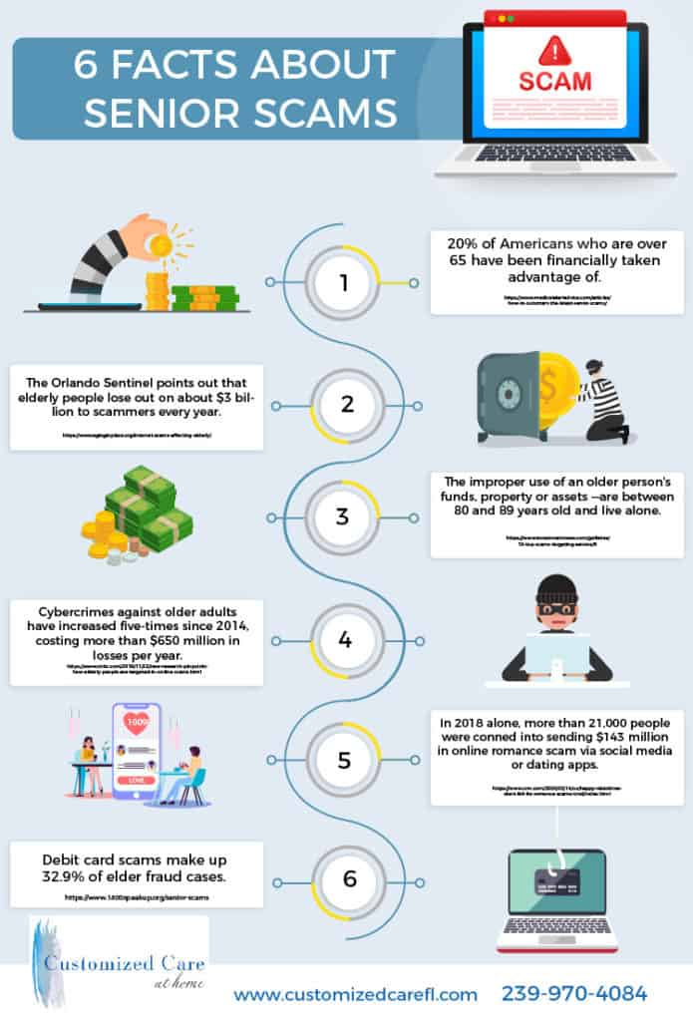
Notes:
https://www.dailyinfographic.com/risk-of-senior-scams

Slide 30
