Slide 1
Petaluma People Services Center
IMPLEMENTATION OF A 24-HOUR CRISIS INTERVENTION RESPONSE TEAM FOR LAW ENFORCEMENT
OLDER ADULTS & MENTAL HEALTH

Slide 2
About PPSC
Celebrating 49 years of service, PPSC is dedicated to improving the social and economic health of our community by providing programs that strengthen the dignity and self-sufficiency of the individual.

Slide 3
PPSC Aging Well Together
Senior Café
Adult Day Respite
Home Delivered Meals
iRide Petaluma & iRide Rohnert Park
Caregiver Support Group
Counseling
You Are Not Alone (YANA)
Case Management
One review of 148 studies concluded that social connections increase the odds of an individual’s surviving over roughly the next seven years by about 50 percent.

Slide 4
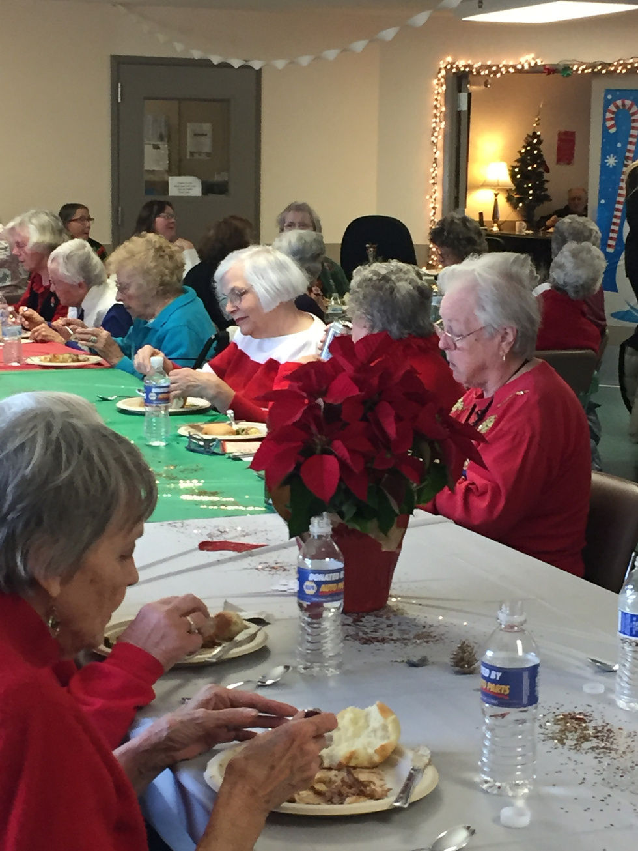
Sonoma County
Case Management
Comprehensive assessment
Client-Centered Care Plan
Coordination of Care Over Multiple Home Visits and/or Phone Conversations
Person-centered assistance to older adults (over 60+) who are at-risk of declining in their overall health, becoming depressed, and/or losing their independence because of diminished social and/or mental stimulation.

Slide 5
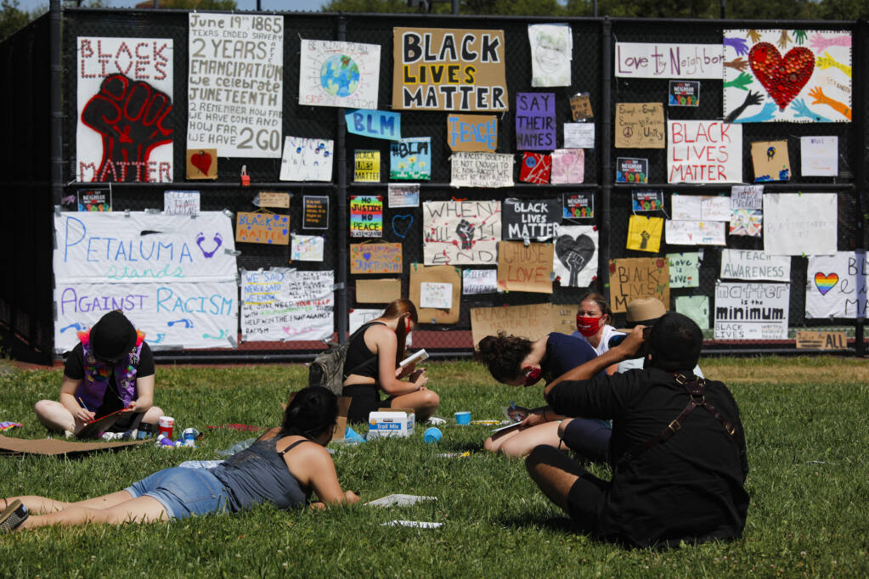
The Kindness Project
Notes:
Elece will use this slide for the introduction
July 2020 – July 2021 Community still in lockdown due to COVID George Floyd The Kindness Committee Leghorn Park City Council July 9 proclamation about art and free speech Petaluma Youth for Cahoots

Slide 6
Specialized Assistance For Everyone
Initial Assessment of Community Needs
In 2020 following requests from the Petaluma Community, the City of Petaluma and the Police Department explored differential policing strategies including the evaluation of the potential for a mobile crisis intervention team.
The City contracted with Crisis Consulting for that analysis and during their study and assessment of a representative sample of public safety calls for service they estimated that approximately 5% of total calls for service could be handled by such a program.

Slide 7
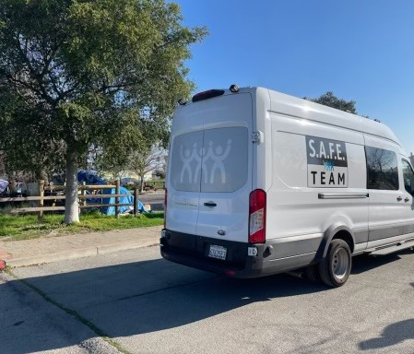
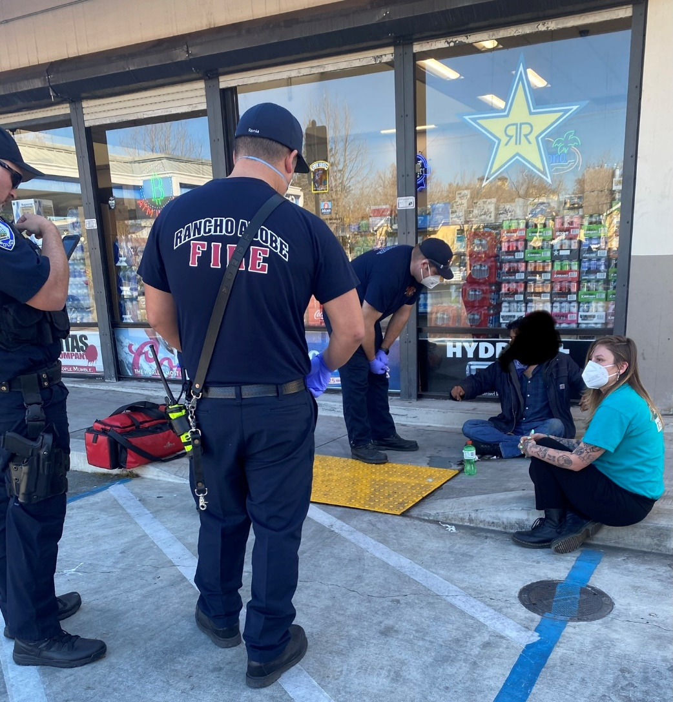
Program Goals
Through the City of Petaluma’s partnership with PPSC the goal of the SAFE team is to address crisis response, prevention and intervention for our most vulnerable community members experiencing crises related to mental health issues, substance abuse issues and homelessness.
The team is made up of specially trained civilian first responders, who respond to and proactively address calls for service that have traditionally (and unnecessarily) burdened law enforcement, emergency medical services and health care providers.

Slide 8
Unintended Results
Between 2015 and 2050, the proportion of the world’s population over 60 years will nearly double, from 12% to 22%
Requires More:
medical care
long-term care
support for age-related health issues

Slide 9
Post Pandemic
more than half of U.S. adults (58%) are considered lonely.
one-third of adults aged 45 and older feel lonely, and nearly one-fourth of adults aged 65 and older are considered to be socially isolated
Source:National Academies of Sciences, Engineering, and Medicine (NASEM)

Slide 10
Social Isolation
Social isolation significantly increases a person’s risk of premature death from all causes, a risk that may rival those of smoking, obesity, and physical inactivity.
Equivalent to:
consuming six alcoholic drinks a day
Smoking 15 cigarettes a day
Source: CDC 2021

Slide 11
Social Isolation
Social isolation probably kills far more people in the West each year than terrorists and murderers, and it costs the public enormous sums in unnecessary health costs.
50% Increased risk Of Dementia
29% increased risk of heart disease
32% increased risk of stroke

Slide 12
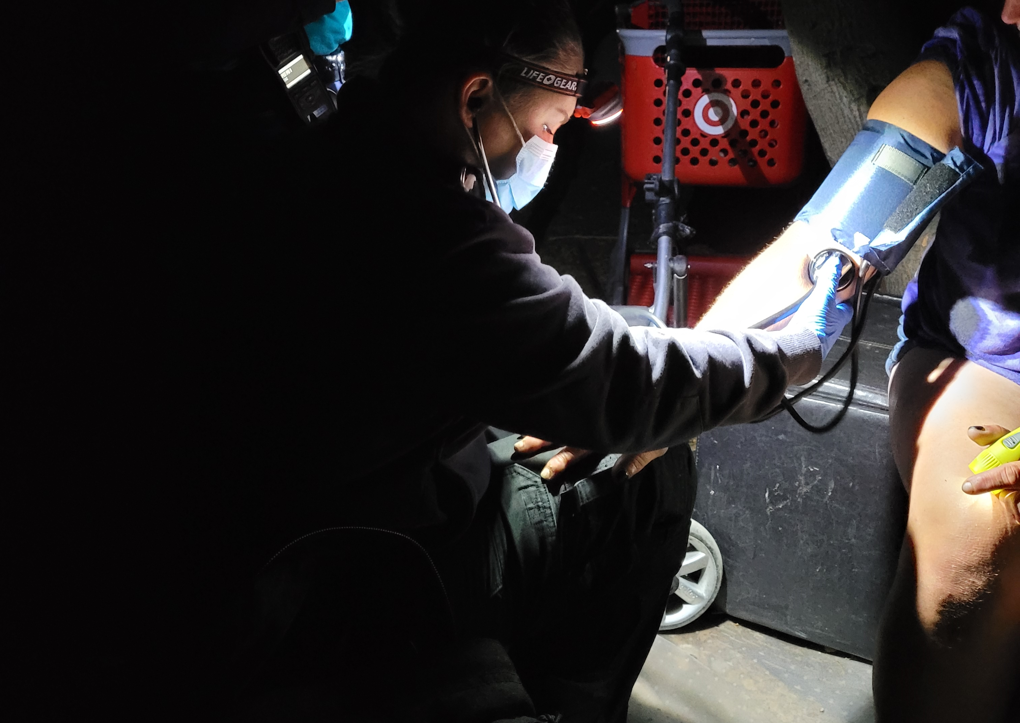
The SAFE Team Successful Outcomes
Assisting community members to become medication compliant.
Assisting community members to secure housing at local shelters.
Alleviated public safety responses stemming from calls from community members experiencing mental health issues and dementia.
Connected community members with psychiatric services and assisted in deescalating incidents.
Preventing and diverting medical and mental health patients from regional Emergency Departments.
Last month, SAFE successfully negotiated for 2 hours with a juvenile on the ledge of the C Street garage threatening to jump if they saw officers.

Slide 13
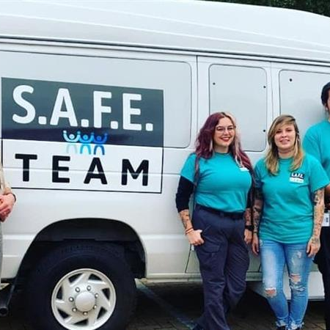
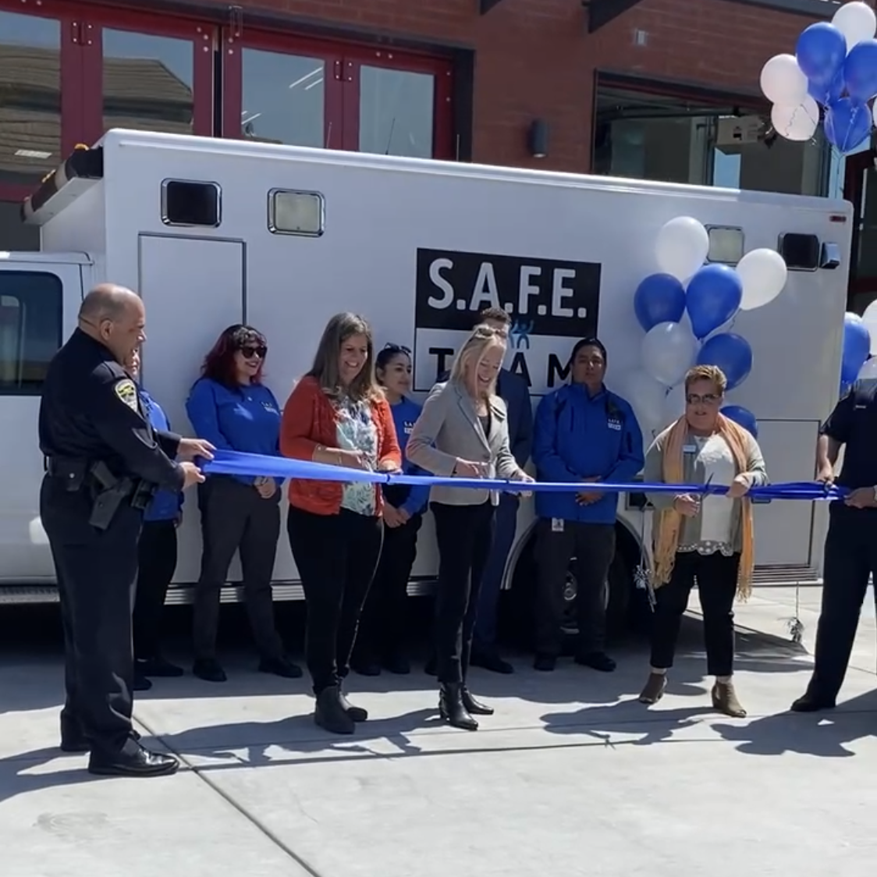
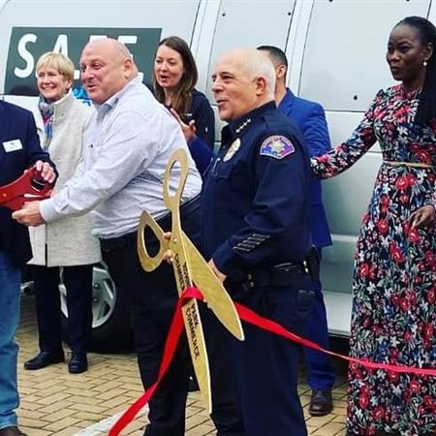
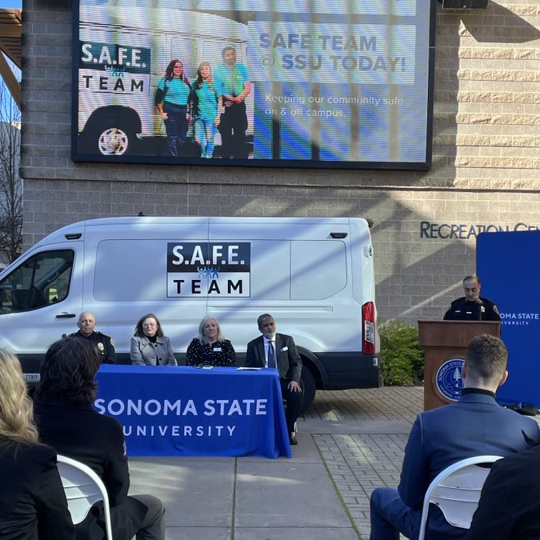
SAFE a model that scales
SAFE has expanded to the serve the communities of Cotati, Rohnert Park, SSU and San Rafael.
SAFE is the first program to serve a University campus and serves Sonoma State University.
SAFE is connected with SRJC and has responded to their campuses to provide assistance.
LAPD recently interviewed Petaluma PD and PPSC staff about the SAFE Team as they are evaluating how to implement a mobile crisis team with similar personnel.

Slide 14
PPSC Executive Director
Elece Hempel
Petaluma People Services Center
1500 Petaluma Blvd S
elece@petalumapeople.org
707-765-8488
Lieutenant
Nick McGowan
Professional Standards Division
Petaluma Police Department
969 Petaluma Blvd North
nmcgowan@cityofpetaluma.org
(707)778-4325 (Direct)
(707)778-4372 (Police Department)

Slide 15
THANK YOU
(707)765-8488 | elece@petalumapeople.org

