Slide 1
Understanding capacity and the strategies used to assess capacity
David Franklin, Psy.D., MHA
Neuropsychologist
Director of the Adult Abuse Forensic Program, County of Riverside
Director of the UCR Comprehensive Sports Concussion Program
Full Clinical Professor, UC Riverside School of Medicine
Department of Psychiatry and Neuroscience

Slide 2
Aging

Slide 3
What Are the Consequences When We Believe these Assumptions?
Inappropriate decisions are made​
Individual rights are improperly curtailed​
Civil rights are stripped​
Premature guardianship orders are entered​
Less restrictive alternatives are not considered​

Slide 4
Synonyms for older adults

Slide 5
Ageism
“Deterioration Model of Aging”: aging is a process of diminishment and decline leading only to death. It is a pervasive bias that leads to the marginalization, silencing, and disregard of older adults, in some cases jeopardizing their safety.​
COVID-19 example—how many times did you hear the severity of the virus minimized, because “only” older people were dying?​

Slide 6
Why a CLINICAL/forensic evaluation?
Patient’s relationship or lack of relationship with their physicians (Clinical Perspective)?
Possible Conflict of Interest
Patient has not seen their practioner for some time
Liability seen as a barrier for taking an individuals’ rights away
Physicians not comfortable with completing a capacity declaration
Multiple mistakes made on the Capacity Declaration forms (GC335 and GC3351-A)

Slide 7
Forensic Eval Cont.
Forensic perspective (Medical Record Review)
District Attorney’s Office (DA) and law enforcement needs supporting evidence for malfeasance.
Time stamp a neurodegenerative process for financial misconduct (please see case example at end) .
Coroner’s office noted suspicious findings.

Slide 8
Evaluating Capacity
Definition of Incapacity: An individual who, for reasons other than being a minor, is unable to receive and evaluate information or make or communicate decisions to such an extent that the individual lacks the ability to meet essential requirements for physical health, safety, or self-care, even with appropriate technological assistance (Uniform Guardianship and Protective Proceedings Act, 1997)
Definition of Competency: Refers to Legal Findings Only

Slide 9
Presumption of capacity to make decisions and self-care
Autonomy for all adults, within the limits of the law, is an important and respected value in this country.
Adults are presumed to have the ability and right to make decisions about themselves and take care of themselves.
They are presumed to have these abilities and rights even in very advanced age or when there are mental problems.

Slide 10
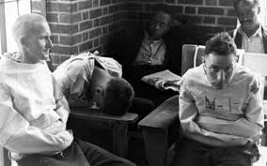
Evaluating Capacity
First Assumption – Patient HAS Capacity
The right to make “bad decisions”
Capacity has to deal with the question at hand
Burden of proof is on the practioner.
Difference between Probate Conservatorship and Lanterman Petris Short (LPS)

Slide 11
Capacity
Capacity can fluctuate​
Medical condition, illness​
Medication​
Time of day​
Events in a person’s life, e.g., grief, loneliness​
Experience and education may be relevant​
Literacy and extent of education may be related to ability to understand complex financial transactions​
Language capacity may be relevant to ability to understand​

Slide 12
Capacity
Having adequate capacity is a judgment of a person’s decision making abilities​
Decision making abilities​
Choice​
Reasoning​
Understanding​
Appreciation​

Slide 13
Clinical interview
THE MOST IMPORTANT PART OF ANY EVALUATION:
FIRST AND FOREMOST: NO!!!
YES!!!!
RAPPORT!

Slide 14
The do’s and do nots!
The DO’s:
Receive as much information as possible
Home visits are essential
Be polite – this is someone else’s home
Try and make the experience as comfortable as possible
Dress the part
Start off with small talk

Slide 15
The do’S cONTINUED
Look around the home
Check to see the photos around the home
Check the refrigerator
Check the bathrooms
Drop the formalities
Ask important questions that pertains to the evaluation
Spend some time with the patient

Slide 16
The do nots!!!
Do not show up in a suit, coat or tie, or lab coat!!
Do not go straight to the question at hand
Do not start going from room to room until you have built some sort of trust
Do not push the patient
Play the dance!!!

Slide 17
Neuropsychological evaluation
NEUROLOGY
PSYCHIATRY
PSYCHOLOGY

Slide 18
NEUROPSYCHOLOGICAL TESTING
Memory; short term and remote
Verbal function; Fluency
Visuo-spatial function
Attention
Executive function
Abstract thinking
Account for education and social function

Slide 19
SCREENING INSTRUMENT
Folstein Mini Mental Status Exam (MMSE)
Montreal Cognitive Assessment (MOCA)
Clock Drawing
Short Portable Mental Status Questionnaire (SPMSQ)
Cognitive Abilities Screening Instrument (CASI)

Slide 20
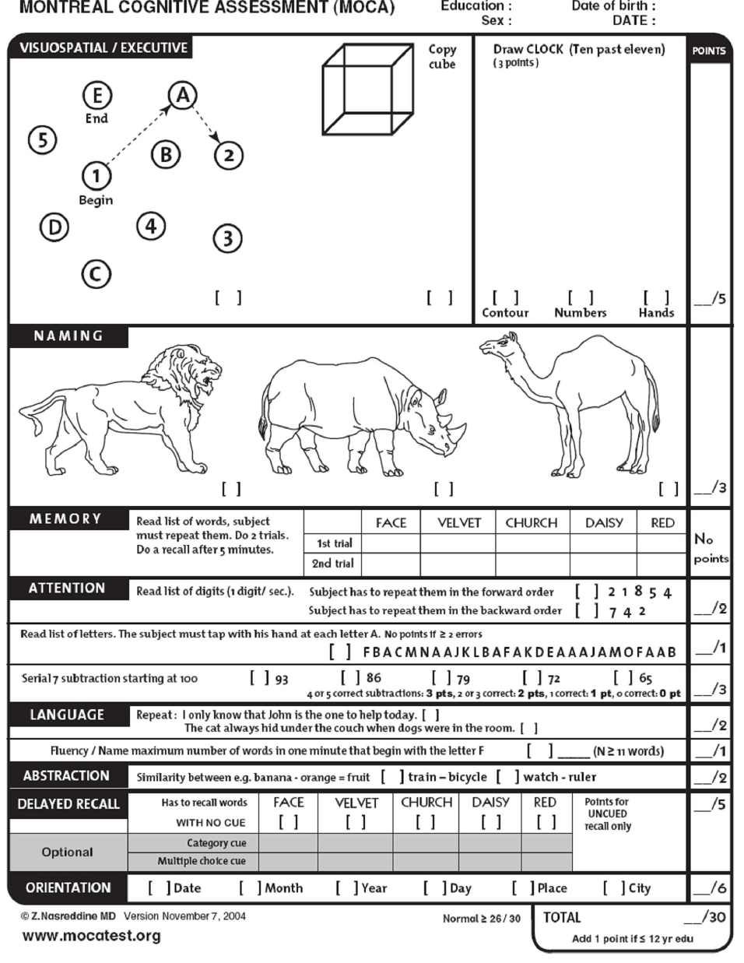

Slide 21
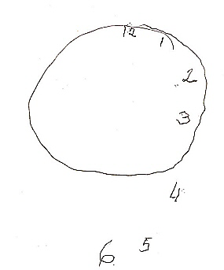
Visuospatial Assessment
Clock Drawing

Slide 22
Not only cognition!
INSTRUMENTAL ACTIVITIES OF DAILY LIVING
COOKING
FINANCES
DRIVING
HOUSEKEEPING
MEDICATION MANAGEMENT
ACTIVITIES OF DAILY LIVING
DRESSING
BATHING GROOMING
TOILETING
BEHAVIORS / PSYCHOSIS

Slide 23
Sometimes you just know!!

Slide 24
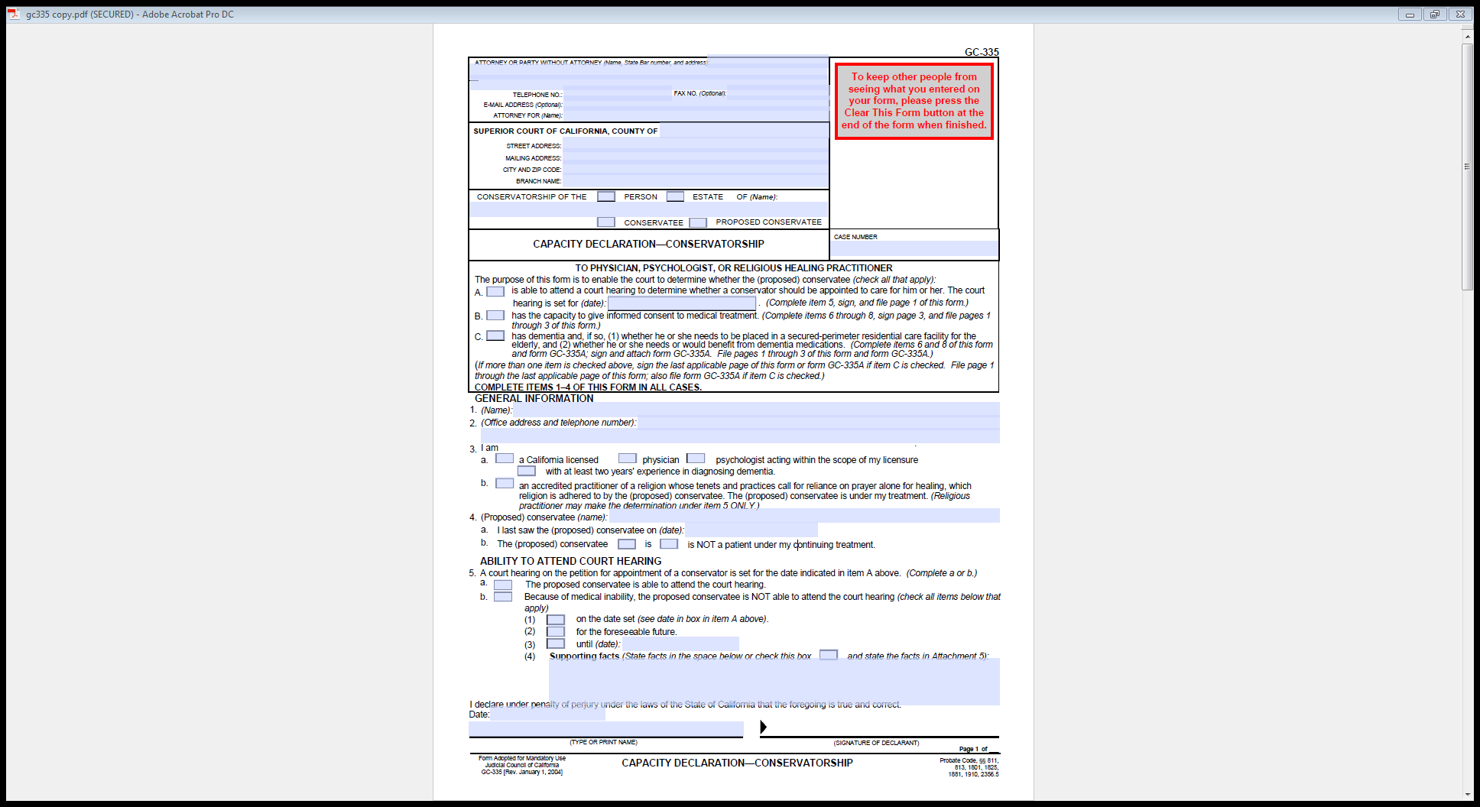

Slide 25
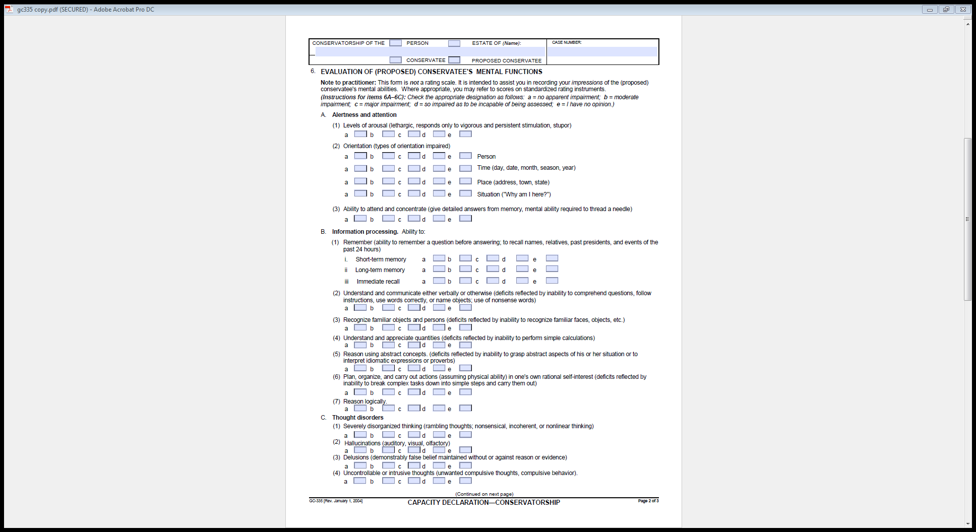

Slide 26
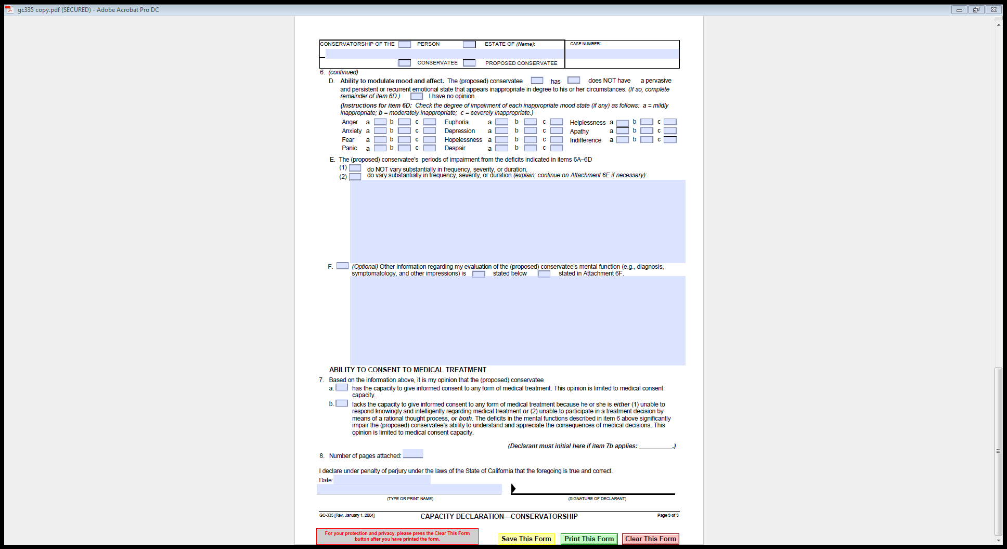

Slide 27
Key Points of capacity
Require an expert’s assessment of capacity​
Focus on person’s abilities​
Difficult to assess​
Presumption of capacity​
Courts must:​
Fact find ​
Determine capacity​
Incapacity = tailor a guardianship; appropriate, safe, and respects the older adult.​
Forms above are all or nothing!! Provide retaining abilities

Slide 28
Multidisciplinary Teams
CARE Team
Elder Abuse Forensic Center
MDTs

Slide 29
Care Team
CARE Coordinators facilitate community multidisciplinary team of professionals from various community agencies
MDT strives to improve coordination among service providers and public safety organizations in combating the abuse of elders and dependent adults
Team members:
Discuss complex cases
Identify unique resources
Share best practices
Client protection/advocacy
Monthly educational topic at every MDT meeting
Legislative Advocacy

Slide 30
What is the Elder Abuse Forensic Center?
The Elder Abuse Forensic Center (EAFC) strives to improve our community’s ability to combat, investigate, and prosecute elder and dependent adult abuse
The EAFC Team collaborates and determines coordinated response plans to improve case outcomes
EAFC

Slide 31
Core members of the EAFC
EAFC Coordinator
Neuropsychologists
Deputy District Attorney
Law Enforcement
Adult Protective Services (Regional Managers)
County Counsel
Ombudsman
CARE Representative
Legal Aid
Victim Services Advocate
Public Guardians Office
Geriatrician
Behavioral Health
ETS
Coroners Office

Slide 32
Goals of the EAFC
Reduce fragmentation and improve communication/problem solving related to preventing and addressing elder/dependent adult abuse, neglect, and exploitation.
Raise public awareness about the multidimensional nature of and challenges associated with elder/dependent adult abuse, neglect, and exploitation.
Educate and improve the competency of service professionals working with the elder/dependent adult population.
Develop and advance practices in the field of elder and dependent adult protective services through the development of standardized tools and innovative research.

Slide 33
Elements of an EAFC Case
Medical, social, legal, and financial complexity that necessitates involvement and services provided by an array of disciplines to ensure client safety.
High-risk self-neglect case where capacity is compromised
Identified suspected abuser
Law enforcement/DA interested in pursing prosecution
Case Examples

Slide 34
EAFC MDT
Who: EAFC core members, adhoc member agencies and individuals associated with the case/investigation are invited to participate in the meeting.
EAFC meetings include brief introductions, a maximum of four scheduled case presentations (20 minutes each), and the development of a Coordinated Response Plan.

Slide 35
What does it take?
TIME
COMMITMENT
TEAM MINDED
FLEXIBILITY
PASSION

Slide 36
Ageism doesn’t only impact older adults

