Slide 1
Mistreatment of African American Elders
University of Southern California
Donna Benton, PhD
Associate Research Professor of Gerontology
September 2023

Slide 2
Objectives
At the end of this presentation participants will be able to:
Compare the demographics of elder mistreatment in African American (AA) populations with other populations
Identify key risk factors for elder mistreatment for AA
Explain social determinates of elder mistreatment in AA communities
Find resources to help when elder mistreatment is suspected

Slide 3
"Although our older adult population is incredibly diverse, many still think of an older American as a white middle-class person. This only shows a part of the picture. Older adults of color make up a rapidly growing percentage of the older adult population"
Vivianne Mbaku July 28, 2021
Elder Law Attorney
source

Slide 4
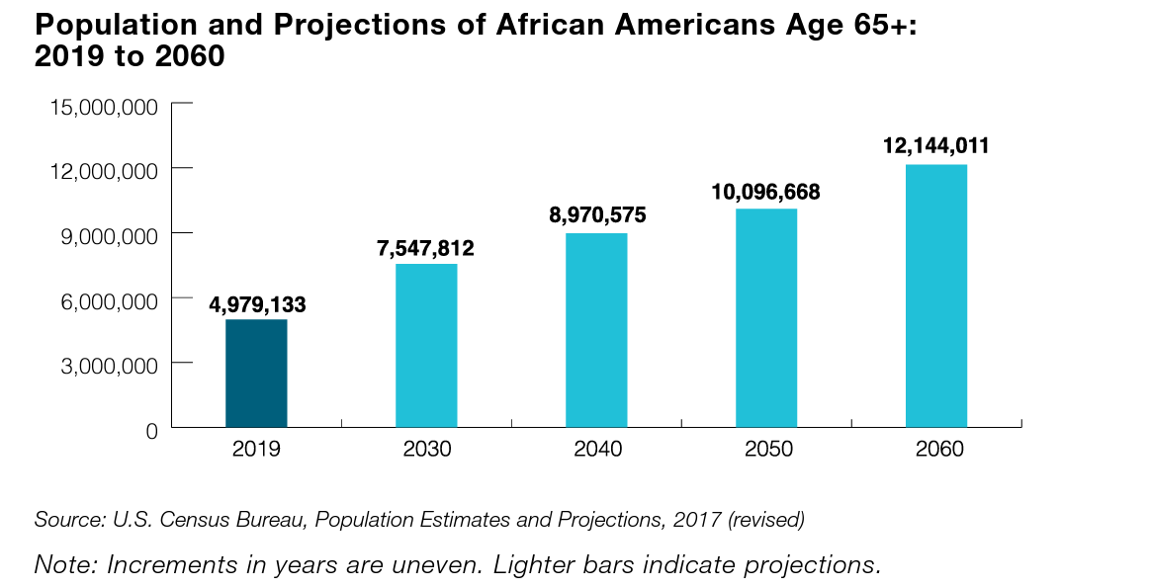
African American population age 65 and older
5 million (2019) to 12.1 million (2060)
9% (2019) of the older population to 13% (2060)
Number of African Americans age 85 and older
increase from 511,540 in 2019 to 2.2 million in 2060.
Source: https://acl.gov/sites/default/files/Profile%20of%20OA/AAProfileReport2021.pdf

Slide 5
Education AA (2020)
81% age 65 and older finished high school and 22% had a bachelor’s degree or higher.
Disparity: 89% of all older persons finished high school and 33% had a bachelor’s degree or higher.

Slide 6
The poverty rate in 2019 for African Americans age 65 & older = 18%
Disparity: 2X rate for all older Americans (8.9%)

Slide 7
Disabilities AA Older Adults
38% have one or more disabilities
Disparity: 33.5% of all older adults age 65 and older.
>20% of Americans with AD are African Americans.
Disparity: 2 to 3X more likely to have AD compared to non-Hispanic Whites ; <5% of clinical trials participants are African Americans

Slide 8
Definitions from Research
Financial Exploitation
Improper use of funds, property or resources by another individual
Psychological Mistreatment
infliction of anguish, pain or distress through verbal or nonverbal acts

Slide 9
Financial Abuse:
"... financial abuse cases are notoriously hard to investigate and prove.​
Key evidence is often in the hands of abusers or financial institutions.
Shame and the fear of making matters worse keep many elder financial victims from reporting the crimes."
Source: https://www.nextavenue.org/elder-financial-abuse/ Lisa Nerenberg August 9, 2021

Slide 10
Barriers for AA Older Adults
Historical and ongoing injustices and abuses increase distrust and decreases help seeking
Disparity: increase risk of exploitation and crimes
https://www.researchgate.net/publication/341566015_Elder_Mistreatment_Across_Diverse_Cultures

Slide 11
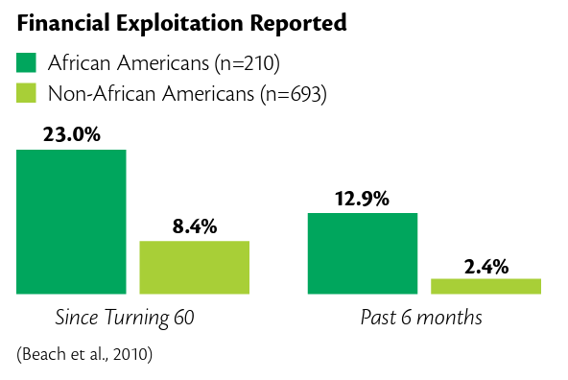
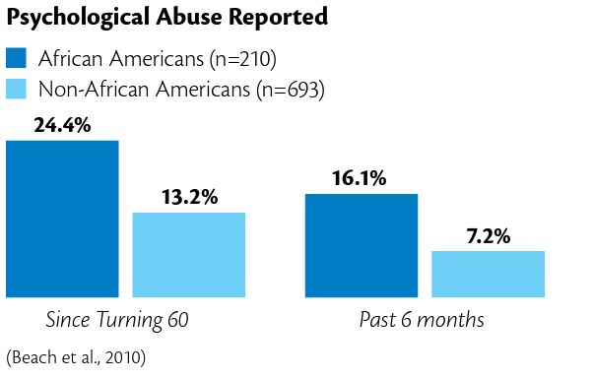
Risk for AA Older Adults
Older African Americans are more susceptible to financial exploitation and psychological mistreatment
Source: https://eldermistreatment.usc.edu/wp-content/uploads/2016/10/ResearchToPracticeAfAm.pdf

Slide 12
Social Justice
For older African Americans risk for elder mistreatment must be understood as an intersections of race, age, class, and health disparities.

Slide 13
Restorative Justice
The model of restorative justice allows us to build on the strengths of the AA while acknowledging risk factors
Source: https://www.americanbar.org/groups/gpsolo/publications/gpsolo_ereport/2022/may-2022/elder-abuse-cases-restorative-justice/

Slide 14
Resources
USC Center for Elder Justice https://eldermistreatment.usc.edu/
USC Center for Elder Justice https://eldermistreatment.usc.edu/national-center-on-elder-abuse/law-and-policy/
Elder Abuse Guide for Law Enforcement (EAGLE) https://eagle.usc.edu/
Training Resources on Elder Abuse https://trea.usc.edu/
Administration for Community Living (ACL) https://acl.gov/
CA Elder Justice Coalition (CEJC) https://www.elderjusticecal.org/
Justice in Aging https://justiceinaging.org/
Burnes, D. Connolly, M.T., Salvo, E., Kimball, P.F., Rogers, G., & Lewis, S. (2022). Rise: A conceptual model of integrated and restorative elder abuse intervention.
Robinson, D. L., Glasner, P., & Rooney, M. (2011). Last will and embezzlement ([Scholastic ed.]). Terra Nova Films [distributor].
Toolkit for AA elder justice

