Slide 1
Reinforcing California’s Elder Justice Infrastructure:
Committing to Equity and Inclusion
Lisa Nerenberg: CEJC Executive Director
Carol Sewell: CEJC Policy Director and A*TEAM Coordinator
Donna Benton, PhD: CEJC Chair and Research Associate Professor of Gerontology, Assistant Dean of Diversity and Inclusion, USC Leonard Davis School of Gerontology

Slide 2
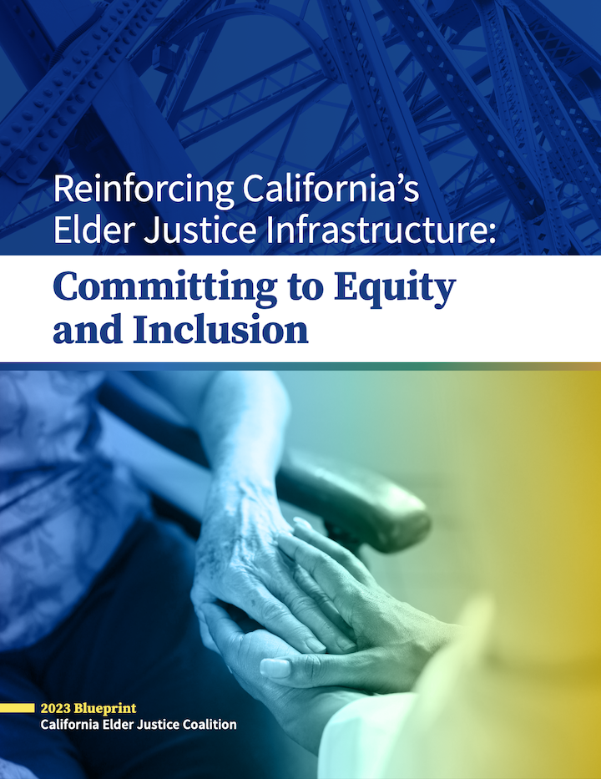
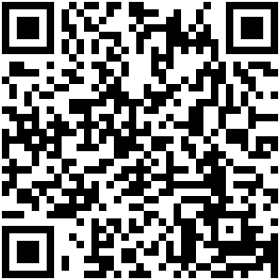

Slide 3
Who We Are
A multidisciplinary membership organization providing a voice from the field in elder justice policy and practice
We advocate for policy reform, create opportunities for exchange among advocates and policy makers, and provide consultation, training, and technical assistance
Raise awareness about EJ and developments in the field through educational materials/events on leading edge issues, including webinars, toolkits, blog, blueprints ​
Join us at: https://www.elderjusticecal.org/join-us.html
Visit our Website at ElderJusticeCal.org

Slide 4
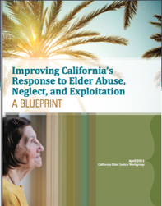
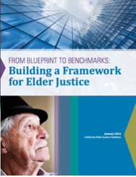
Elder Justice By the Book

Slide 5
From Blueprint to Benchmarks Building a Framework for Elder Justice (B2B)
B2B:
Describes achievements that followed the 2010 EJ summit as well as new developments and needs in nine focus areas.
Proposed new directions and priorities for improving California’s response to elder abuse, neglect, and exploitation, and ensuring justice for older adults in California.

Slide 6
B2B In Action!
CALIFORNIA’S ELDER & DISABILITY JUSTICE COORDINATING COUNCIL
Created through the Master Plan for Aging in 2021
State Agency and stakeholder representatives focused on systemic issues across the state bureaucracy
EDJCC Conservatorship Workgroup created to improve understanding and messaging around Probate Conservatorship, access to data, program coordination and funding.
CEJC’s A*Team - Statewide team of advocates, policy analysts, experts, and stakeholders to explore systemic barriers to elder justice

Slide 7
B2B In Action (cont.)!
Legislative Analyst’s survey of County funding for APS
EDJCC’s APS Workgroup gap analysis, review of mandated reporting, collaboration between APS and PG.
EDJCC’s Legal Services Workgroup studying the scope and availability
of legal services.
CEJC Elder Justice training for legal service providers
CEJC advised CalOES in the development of new VOCA grants for victim services, creating of new MDTs, legal services, support groups, & direct service providers serving older
victims.

Slide 8
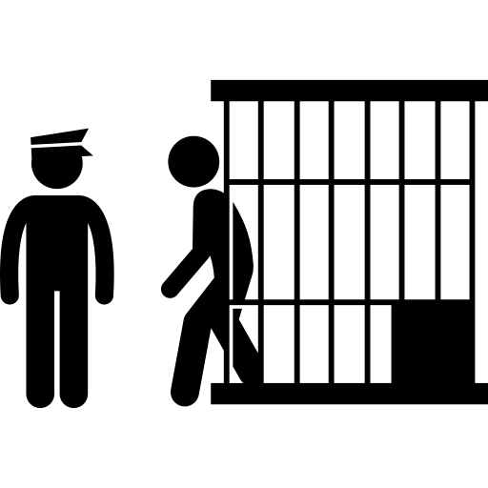
Equity and Diversity: Intersectionality of Justice
Who are the underserved communities ?
Rural
BIPOC
Formally Incarcerated
Cognitively Impaired
What are the Promising Practices ?
Restorative Justice
Legislation to reduce continued predatory practices.

Slide 9
“In Bayview, San Francisco, you have a lot of low-income Black families that moved up during the great migration, but as a whole have lacked social mobility and been the target of racist redlining and employment policies. So, now, you have tons of low-income families that own homes worth nearly $1 million dollars free and clear but don’t have the liquid funds to pay $3-4,000 for a revocable living trust to avoid probate. If that family goes through probate, they will certainly lose the home and be displaced.”
– Sil Vossler, Vossler Law Firm and CEJC Steering Committee member

Slide 10
Outreach
We are developing collaborations with the Native American Communities, advocates for incarcerated elders and those reentering their communities, and older Californians living in underserved rural communities through:
Partnerships
Collaborations
Listening sessions

