Slide 1
Understanding the Harm of Ableism in Preventing Elder Abuse
Elder Justice Summit Sept 20, 2023t
This presentation material is developed by Ali Chiu and members of National Human Trafficking and Disabilities Working Group

Slide 2
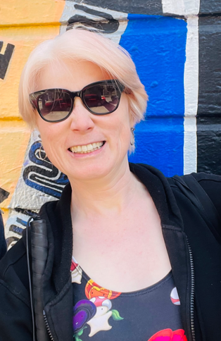
Ali Chiu
Ali Chiu has been a public service provider since 1999. Her focus has been on anti-violence (domestic violence, gender-based violence, sexual exploitation, & human trafficking). She also has been an advocate on rights of seniors and people with disabilities. She is currently the Lead Supervisor of Consultative Services of Institute on Aging and is a Steering Committee member of the National Human Trafficking and Disabilities Working Group. Ali also holds a community seat on the San Francisco Family Violence Council. Ali is a survivor of domestic and sexual violence, a woman of color, an immigrant and a person with a disability.

Slide 3
Grounding
Acknowledge your Intentions
Centering Survivors/Victims
Examine Your Assumptions and Biases
Explore Support
Create Collective Access

Slide 4
Training objectives:
Explore the U. S. history of disability and the relevant movements in relationship to current policy and laws
Explore the definition of ableism, its different forms, and the relevance of language, culture, and barriers
Discuss critical, respectful, and accessible tools when responding to reports of abuse

Slide 5
You are a 56-year-old Chinese American woman living with your partner in San Francisco. You and your partner bought your apartment together 10 years ago, mostly with money from your parents. You have lived with several disabilities for most of your life. You use a wheelchair outside, and at home, you manage basic tasks with your attendant, who comes in a few days a week. You enjoy swimming, writing, and reading. You are an editor, but you haven’t been getting enough work lately. You have a Labrador named Ruby as your service animal. You and your partner have been together for over 25 years. Your partner is a homebody who loves to cook, write, and watch movies on the computer. Your partner also likes to keep your apartment extremely clean and does not like to have people over. You, on the other hand, enjoy seeing friends and often enjoy entertaining friends at home. You believe the aforementioned issues to be at the core of your longstanding conflicts. In response, you have begun to go out more rather than have people over, but your conflicts persist...

Slide 6
Situation 1
A couple of weeks ago, you and your partner had an argument over Ruby being sick in the apartment. You tried your best to clean it up, but your work didn’t meet your partner’s “standard” so your partner pushed you out of your wheelchair to stop you from going out to meet with your potential new boss. You fell on your face, chipped your front tooth and bruised the left side of your face, along with your arms and legs.
stay home
domestic violence shelter
your sister’s place
motel (you only have $2000 cash)
friend’s house (Oakland not near public transportation)
What would you do?

Slide 7
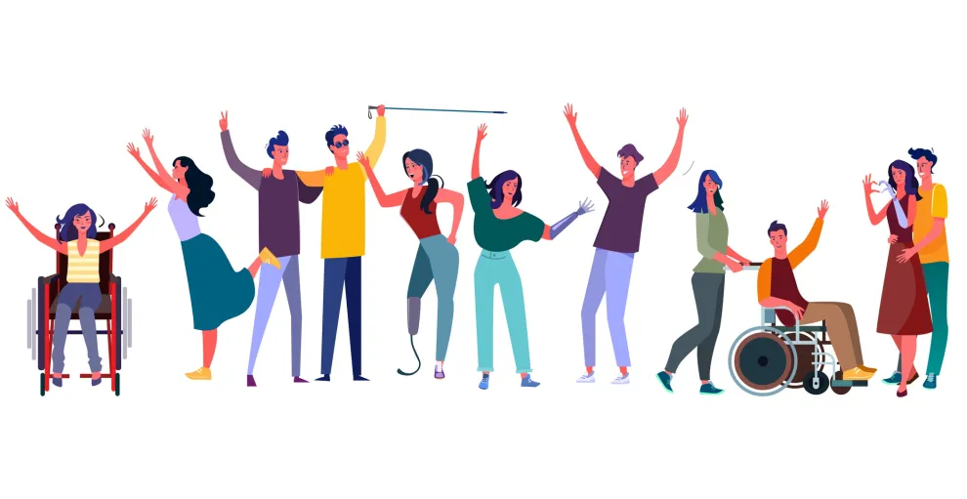
Demographics of Elders and Dependent Adults
An NPR investigation finds people with intellectual disabilities are raped at a rate seven times higher than those without disabilities.
Women with disabilities have a 40% greater chance of intimate partner violence than those without disabilities
According to the U.S. Department of Justice Crime Against Persons with Disabilities report (2009-2019), women and girls with disabilities face the highest rates of physical and sexual violence.
According to the Centers for Disease Control & Prevention, 27% of the U.S. population, or approximately 61 million Americans identify as people with disabilities. That’s one in four people, making persons with disabilities the largest and most diverse population group in the country, representing all abilities, ages, races, ethnicities, religions, and socio-economic backgrounds.

Slide 8
Brief Overview of Disability Rights U. S. History
Ugly Law
Eugenic Movement
Independent Living Movement
Sec 504 Rehab Act
Fair Housing Act
ADA
Olmstead Decision

Slide 9
A system that places value on people’s bodies and minds based on societally constructed ideas of normality, intelligence, excellence, desirability, and productivity.
These constructed ideas are deeply rooted in anti-Blackness, eugenics, misogyny, colonialism, imperialism, and capitalism.
This form of systemic oppression leads to people and society determining who is valuable and worthy based on a person’s language, appearance, religion, and/or their ability to satisfactorily [re]produce, excel, and "behave.“
ABLEISM a·ble·ism \ ˈābə-ˌli-zəm \ noun
You do not have to be disabled to experience ableism.
- a working definition by Talila "TL" Lewis*; updated January 2021 Developed in community with Disabled, Black and other negatively racialized people, especially Dustin Gibson.

Slide 10
Language Consideration
Do NOT use “paralyzed” “crippled” and/or “demented” to describe your feelings, your fear, the traffic home, the current economy, etc.
Dumb, lame, insane, crazy do NOT mean unintelligent or stupid
Understanding our privilege when we speak. Words have power.
Not using words and/or phrases that would continue to perpetuate oppression
Dumb, lame, insane, crazy, DO NOT mean unintelligent or stupid
It is ageist to use a phrase such as “having a senior moment” when referring to “forgetfulness”
Do NOT use “paralyzed”, “crippled” and/or “demented” to describe your feelings, your fear, the traffic home, the current economy, etc.
Wheelchair-bound, handicapped and the “R” word are harmful, and NOT people with disabilities like to be described.
Wheelchair-bound, handicap and the “R” word are harmful and NOT how people with disabilities like to be described

Slide 11
Abuse Through Ableist Lens
Physical — Hitting, pushing, punching, slapping, under and/or over-medicating.
Isolation — using “disabilities culture” to isolate survivor, denial of access to communication, information, pathway, healthcare, culture and religious practice, and more
Emotional —Using “disability” to manipulate and control, threats, put-downs, name-calling, ridicule of personal/cultural beliefs, threats against family members, pets, immigration/disabilities/LGBTQ+ & HIV status, minimize, and manipulate .
Financial – No access or knowledge of money movement, control of spending/non-spending, access of employment/education, trafficking/exploitation
Abandonment –Refusing to provide proper food, housing, or medical care.
Sexual —Inappropriate unwanted touching, watching, recording, or photographing. Inappropriate unwanted massages, non-consensual intercourse, exposing of genitals, exposing to pornography.
Neglect – Failing to meet basic needs of daily care including water, hygiene, clothing.

Slide 12
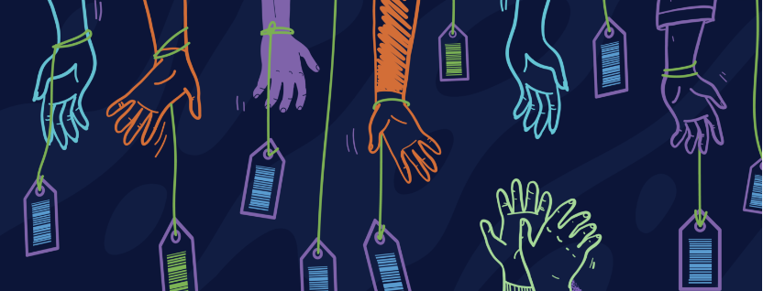
People with disabilities are also vulnerable to human trafficking
Some known exploitation cases of people with disabilities in the U. S.
57 deaf Mexican immigrants including three pregnant women and 12 young children trafficked to work in New York *1997
Iowa Turkey processing plant – workers with developmental disabilities exploited, some for over 60 years *2014
Rock River Valley Self Help Enterprises of Illinois pays workers with disabilities gift cards - *2018

Slide 13
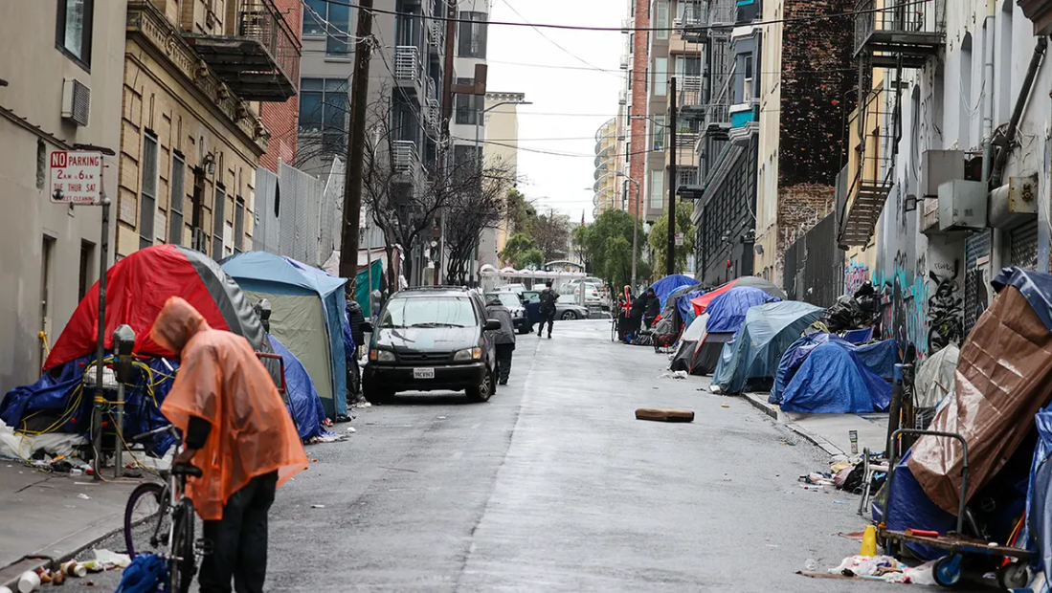
A human trafficking case
in San Francisco 2021
Danielle was 47. Her sister was supposed to manage her SSI and CalFresh (food stamp) benefits but because her sister didn’t pay her rent on time for many months Danielle was evicted and became homeless. She had no tools to access her CalFresh Food Stamp) and depended on free meal programs. Furthermore, Danielle was sexually exploited on the street and physically assaulted many times.
*name of victim changed for confidentiality

Slide 14
Lack of reasonable accommodations
Physical Barriers
Communication Barriers
Program Barriers
Believability/Credibility/Respectability Barriers
Financial/employment barriers
Absence of accessible Long term supports
Domestic/Caregiver Abuse
Abuse to Prison Pipeline
Lack of trust for police/government interventions
Barriers for people with disabilities to reach out when experiencing abuse

Slide 15
Prioritizing Survivor Safety
Consider
Consider the impact of carceral living conditions when recommending “safe/accessible housing” options for survivors with disabilities
Question
Question with the intent to invite conversation rather than an atmosphere of interrogation
Offer
Offer support that incorporates physical, mental, emotional, financial, and spiritual safety as appropriate
Create
Create an ever-evolving infrastructure of disability inclusive contacts/partners
Provide
Provide rapid responses to accommodation requests
Promote
Promote available accommodations/connection options widely

Slide 16
Steps Toward Survivor Centered Response
Focus on the needs rather than trying to diagnose specific disabilities, diseases, or disorders
Peer Support Advocates
Objective Observers (trafficking/domestic violence representatives, mental health teams, disability centric organizations, faith-based groups etc.)
Community Resource Specialists/Mutual Aid Groups
Community Based Public safety groups
Interpreters/Communication Specialists
Disability Oriented Forensic Interviewers
Disability Rights Attorneys

Slide 17
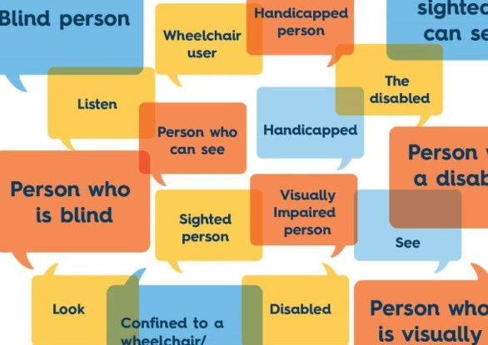
Language Access
Individuals with LEP (Limited English Proficiency) are those individuals who do not speak English as their primary language and have a limited ability to read, write, speak, or understand English.
Deaf (upper case ‘D’) refers to an identity with its own culture, language, and diverse communities
deaf refers to a physical condition
Deaf and hard of hearing are often understood as a disability issue, but it is also a language access issue.
The perception that someone who is LEP is uneducated or untrustworthy. Similar situations might happen to deaf or hard-of-hearing people or people with disabilities in general.
When using ASL interpreters, ADA guidelines on communication
Do NOT use an accompanying adult/child to interpret when there is reason to doubt the person’s impartiality or effectiveness
Do NOT use family members/spouse as an interpreter

Slide 18
Nothing About Us Without Us
People with disabilities are our family members, teachers, educators, policymakers, lawyers, social workers, co-workers, mentors, neighbors, spiritual leaders, and more. From whom a lot of wisdom and experience we can and should learn.

Slide 19
Thank You
The Elder Abuse Prevention Program
of Institute on Aging is funded by the
Department of Disability and Aging Services
of San Francisco

